Slide 1
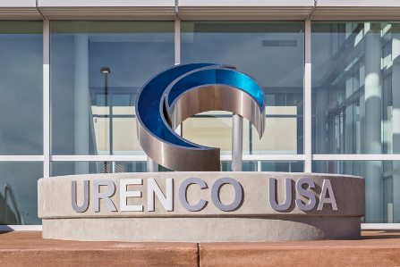
Karen Fili, UUSA President & CEO
3rd Annual
New Mexico EnergyPlex Conference
25 June 2019, Hobbs
Notes:
Introduce yourself as the new President & CEO of URENCO USA.
- length of time in position
- background in the industry
- personal statement about how you feel about leading UUSA in the next phase of growth

Slide 2
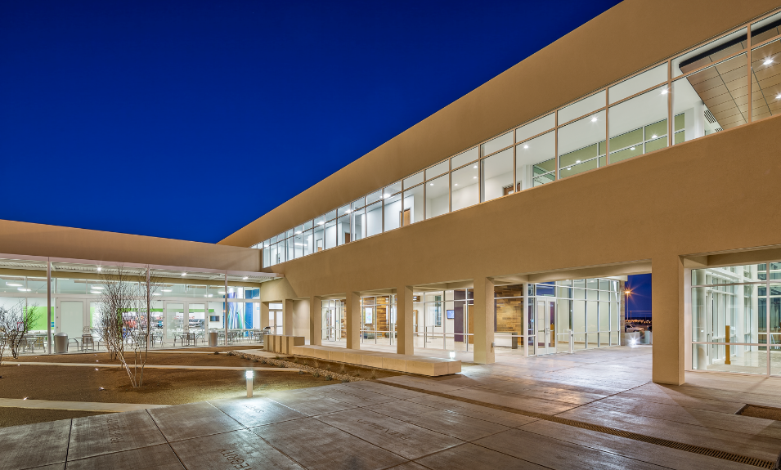
First Impressions of The National Enrichment Facility

Slide 3
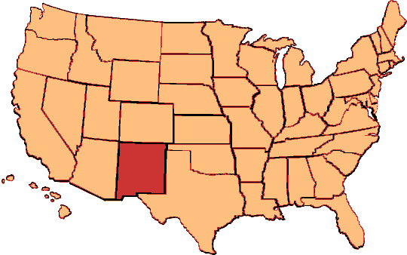
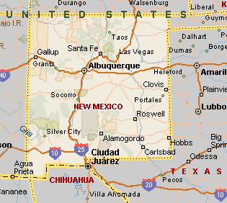
URENCO USA History
Located in southeast New Mexico
1st new nuclear facility in the US in more than 30 years
Nuclear Regulatory Commission license issued in 2006
Operation commenced in 2010
Only uranium enrichment plant in North America

Slide 4
Global Facts
4 Enrichment Facilities
50 Customers
1,500 Employees
19 Customer Countries
18,800 Current Production
Capacity tSW/a

Slide 5
Long-term Partner to the Nuclear Industry

Slide 6
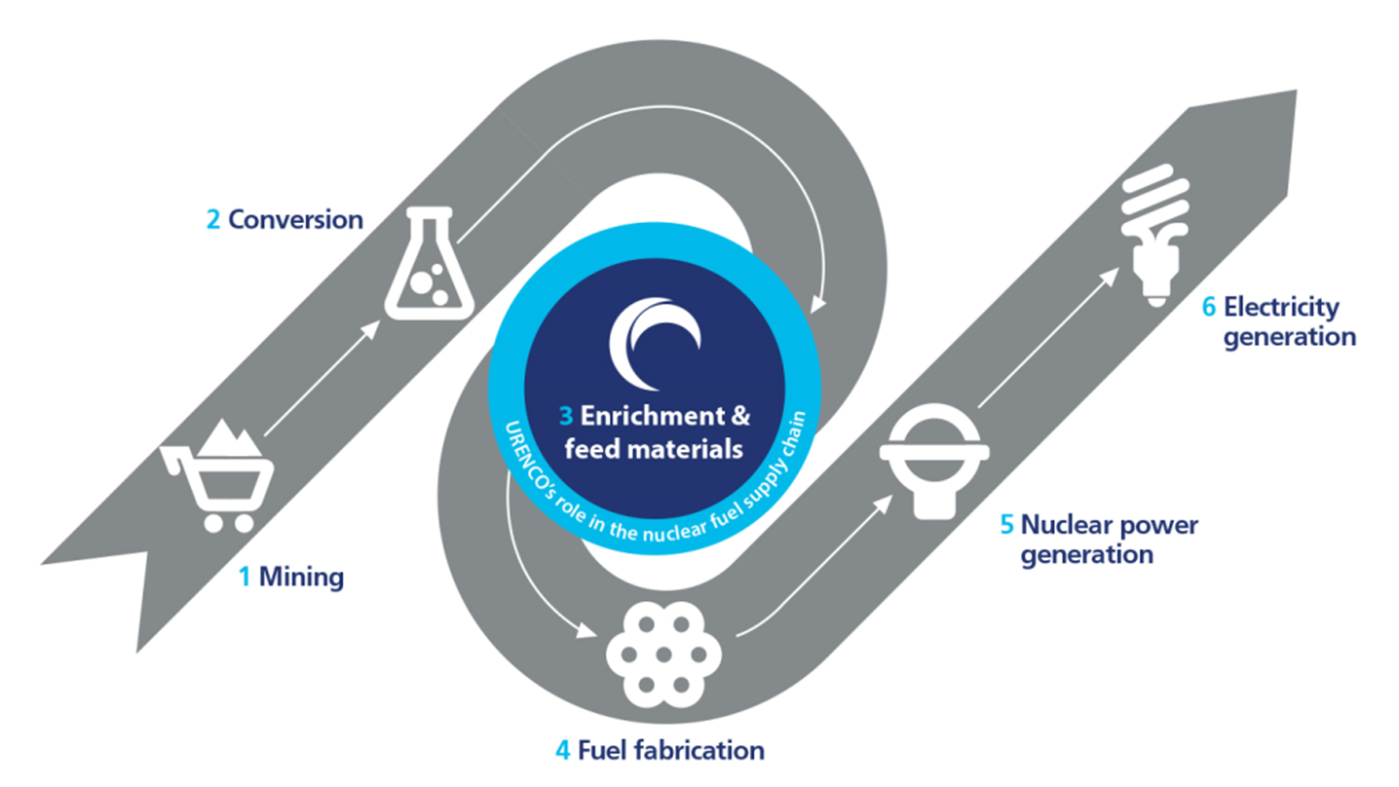
Nuclear Fuel Cycle
Notes:
We are all familiar with today’s established front-end nuclear fuel cycle and the role of enrichment as a “toll-service” to the industry.
This is dominated by fuels for Light Water Reactors:
Low Enriched Uranium up to 5%;
Uranium Oxide fuel pellets; and
Zirconium Alloy fuel rods and assemblies.
This paradigm is changing and post Fukishima the industry may be force to change.

Slide 7
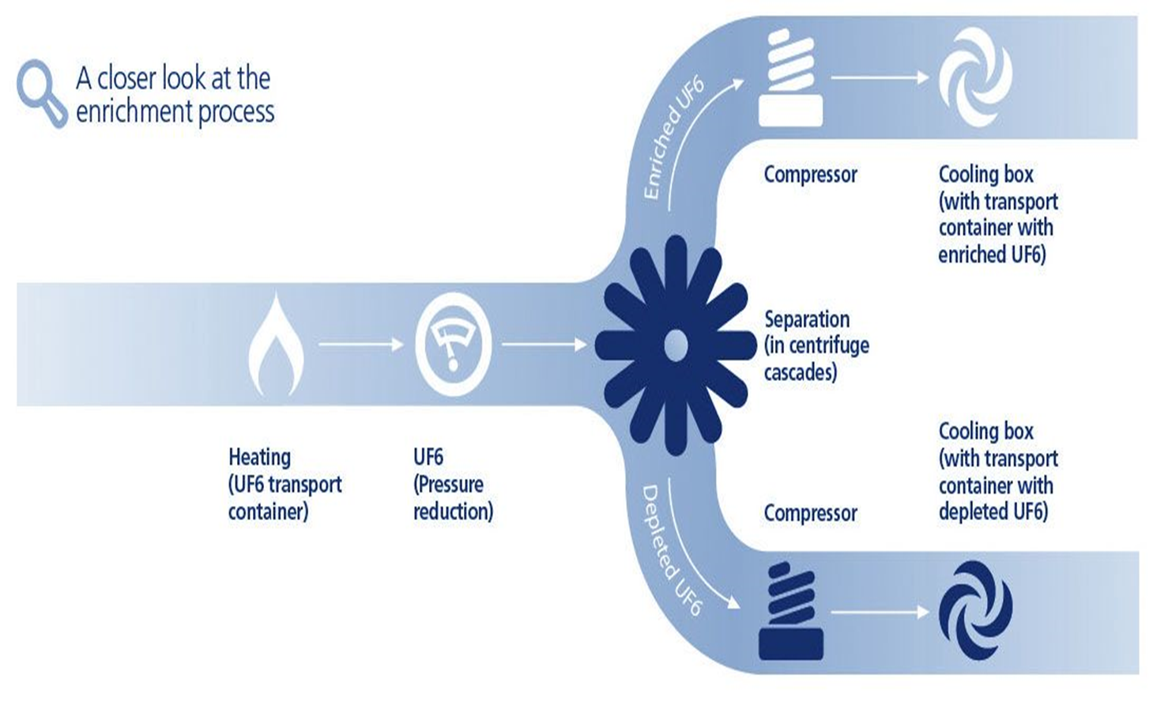
The Enrichment Process

Slide 8
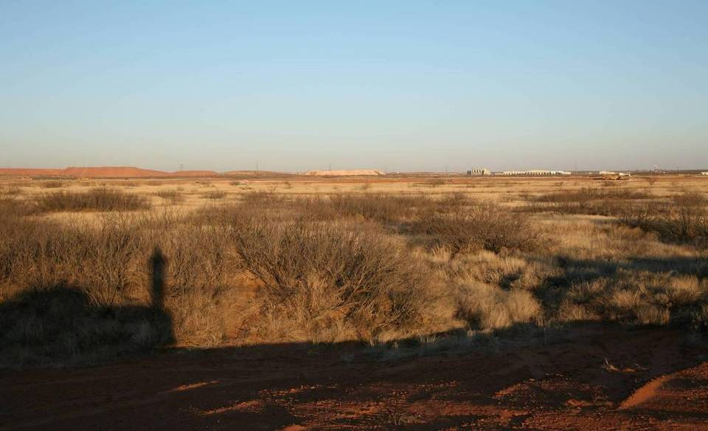
Project History - 2006

Slide 9
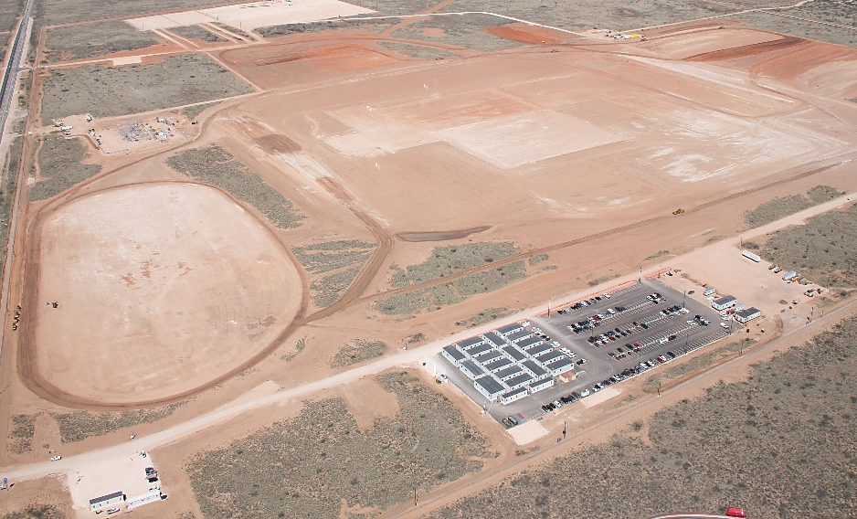
Project History - 2007

Slide 10
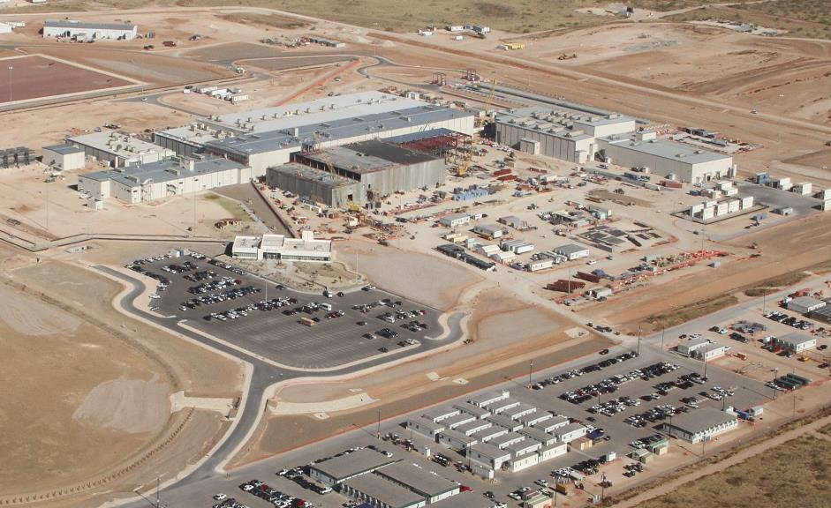
Project History – 2011 (Phase II)

Slide 11
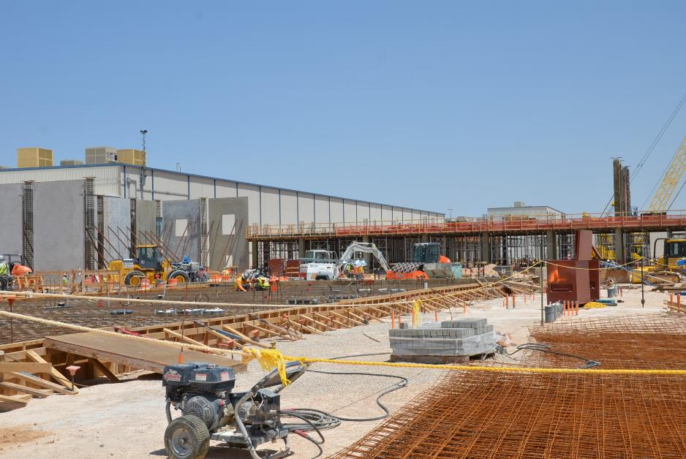
Project History – 2013 (Phase III)

Slide 12
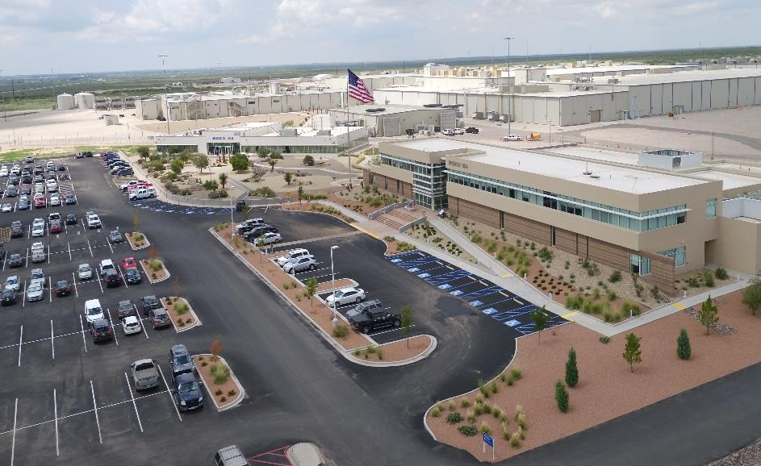
UUSA Today
Current Capacity – 4.9 Million SWU
Current Employees – 230
Provides one third of the U.S. demand for enrichment services

Slide 13
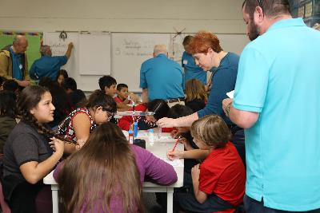
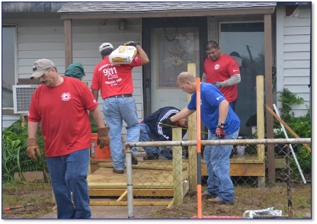
Community Engagement
Richie Enrichment Science Workshops
9/11 Day of Service
United Way Giving

Slide 14
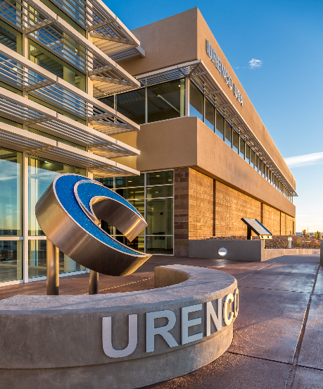
UUSA Site Priorities
Safety
People
Sustainability

Slide 15
Urenco USA HA-LEU Announcement
+++++ PRESS RELEASE +++++
On February 5, 2019 Urenco USA Inc. announced its capability in the provision of high assay low enriched uranium (HALEU), for civil, peaceful applications in existing and new power plants as well as for research, test and medical isotopes facilities.
Urenco is now exploring the construction of a dedicated HALEU unit at its UUSA facility.
Further activity at UUSA is underway to support the near-term delivery of slightly greater than 5% U235 enrichments for existing light water reactors interested in higher burn-up rates and/or extended operating cycles.

Slide 16
HA-LEU
High Assay - Low Enriched Uranium (HA-LEU)
Refers to UF6 enrichment in the range of 5.0% to 19.99% U235
URENCO uses the term LEU+ to refer to UF6 enriched just above the current 5% limit for civil nuclear production
A Broad Community of Users will Benefit from HA-LEU
Operators of existing LWRs seeking improvements in reactor economics through higher burnup rates and extended operating cycles
The introduction of Accident Tolerant Fuels
Gen IV and other Advanced reactor designs
Advanced fuel designs
Research & Test Reactors
Producers of targets for medical isotope production

Slide 17
Thank You

