Slide 1
Renewable Energy. Sustainable Future.™
160+ Projects
North America
4 Billion kWh
And Counting
1.3 GW
Operating Assets
13+ GW
Operating |Construction |Pipeline

Slide 2
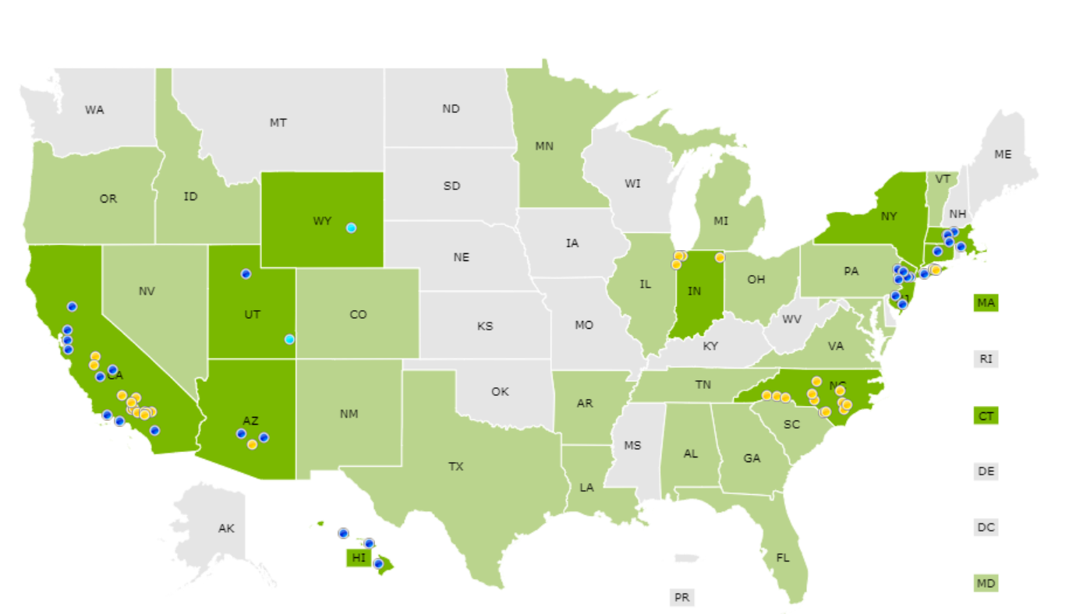
Project Portfolio
1.3 GWdc | 4,900,000,000 kWh Generated

Slide 3
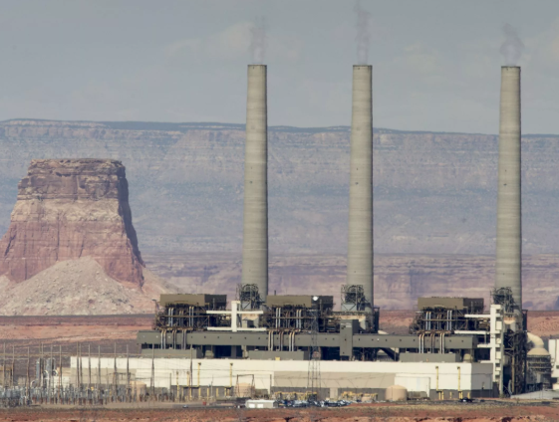
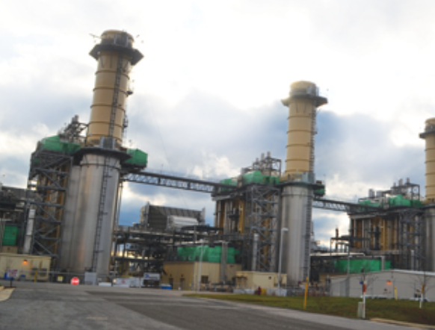
Current Diversity
SPP Generation
Energy production: 266.4 TWh in (2017)
45.3% coal
22.1% wind
19.1% natural gas
6.7% nuclear
6.4% hydro
0.2% other (fuel oil, solar, biomass)
Generating capacity: 87 GW (Jan. 1, 2018)
41.5% natural gas
29.7% coal
20.2% wind
3.9% hydro
2.4% nuclear
1.9% fuel oil
0.1% other

Slide 4
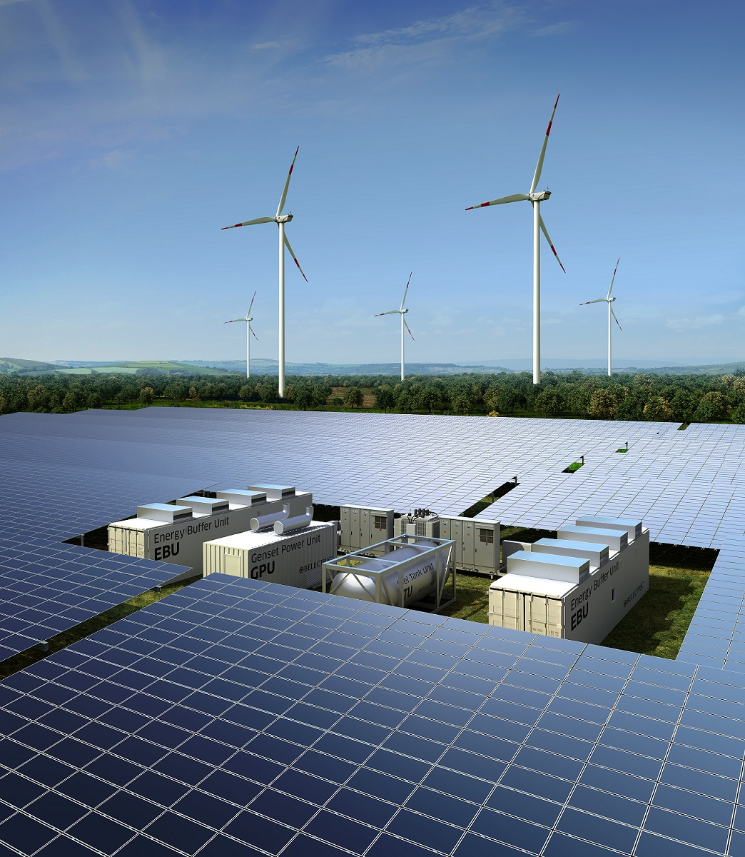
Renewable Energy Change
Paradigm Shift
Paradigm shift
Wind PPAs have dominated.
Wind is Reaching Saturation – peaking between 50-60% of load.
As PTCs starts diminishing and LMPs start sinking in wind rich area, solar is expected to be provide significant value.
Reliability Is Becoming a focus
Utilities are expected to address reliability issues if both wind and solar penetration gets higher
Transmission Capacity Issues
LMP pricing becomes an issue
Ancillary services and a shaped energy product
solution
Energy Diversity
Shaped and Firmed Energy Products

Slide 5
How Does Solar Provide Value?
Adding solar to existing wind
Project Summary:
Size: 240 MW
Location: Lea County, NM
Site Control: 1,920 acres secured
Interconnect:
Transmission Provider: SPP
Facilities Owner: SPS/Xcel
solar
Wind
Highlights:
Solar production profile “fills in” wind production throughout the year
Resulting shape is more attractive and should be seen as easier to manage by utility
Daytime energy production is more valuable as witnessed by higher LMP prices
Provides energy diversity in a wind dominated area

