Slide 1
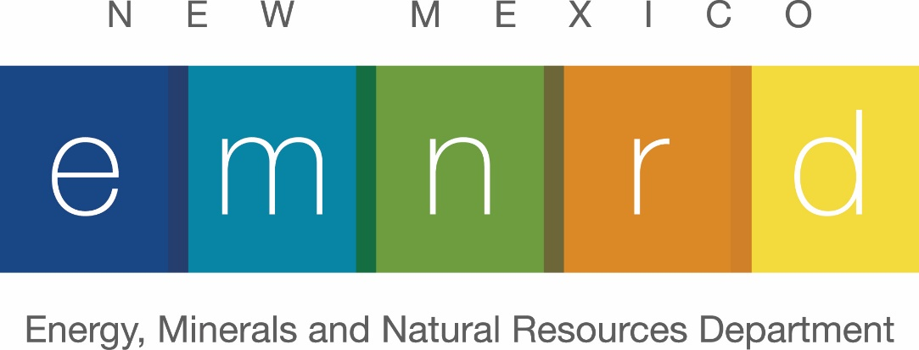
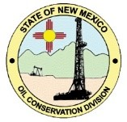
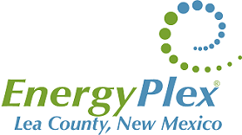
An Overview of the Current OCD Underground Injection Control (UIC) Program
Heather Riley, Director
New Mexico Oil Conservation Division

Slide 2
NMOCD Statutory and Regulatory Responsibilities
Prevent waste
Protect correlative rights
Protect public health, fresh water and the environment
Encourage reuse and recycling of produced water

Slide 3
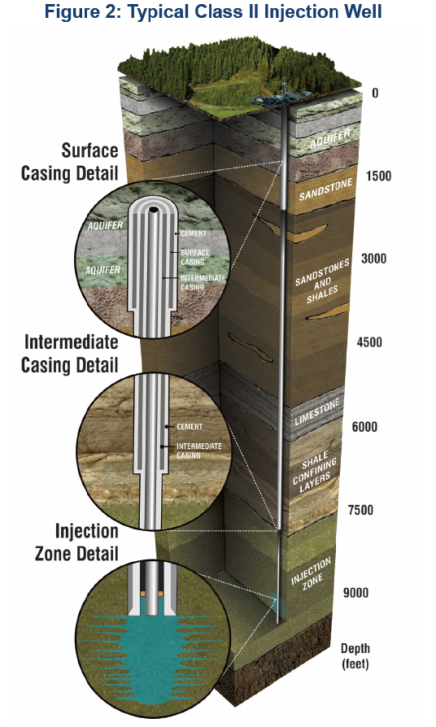
State Primacy Under the Safe Drinking Water Act (SDWA)
In 1981, the Oil Conservation Division provided the USEPA with a Program Demonstration, called the New Mexico State Demonstration for Class II Wells, as required under Part C, Section 1425 of the SDWA (Public Law 93-523 as amended).
Following the review by USEPA, the Program Demonstration was accepted and the state was approved for primacy effective March 7, 1982.
This primacy allowed the Division to issue permits, referred to as “orders”, and regulate operations for Underground Injection Control (UIC) Class II wells.
This primacy agreement resulted in rulemaking which is found in the New Mexico Administrative Code (NMAC) under Title 19, Chapter 15, Part 26 Injection.

Slide 4
State Primacy Under the Safe Drinking Water Act (SDWA)
The current method of application for an order approving injection begins with the submission of Form C-108 that contains the following information:
  identification of the proposed injection interval and the underground sources of drinking water (USDWs) in the area;
  a suitable drilling, casing, and cementing program that protect USDWs;
  a review of penetrating wells within one-half mile;
  notification of affected parties within one-half mile;
  operation plan along with a description of the sources of fluids to be disposed in the well.
The applicant must be an operator in the state of New Mexico and must be in compliance with Division rules on financial assurance and inactive wells.
If the application is protested, then the application cannot be considered for administrative approval and must be considered in a hearing before an examiner or the Oil Conservation Commission.

Slide 5
State Primacy Under the Safe Drinking Water Act (SDWA)
Three groups of injection activities are approved under 19.15.26 NMAC:
  Enhanced recovery: primarily waterfloods, water alternating gas (WAG) flooding operations, and pressure maintenance projects
  Hydrocarbon storage: injection wells for the underground storage of liquified hydrocarbons
  Disposal Wells: produced water disposal wells and acid-gas injection wells. Disposal wells for produced water are referred to as both UIC Class II wells or salt water disposal (SWD) wells
Exempted E&P Waste
  UIC Class II or SWD wells are permitted to accept waste resulting from oil and gas exploration and production (E&P). These wastes commonly include produced water associated with production from a well, well completion and stimulation operations (including flowback), drilling fluids, workover wastes

Slide 6
Additional Requirements for Review of Injection Applications
Along with authority granted to the state under the SDWA, the New Mexico Oil and Gas Act of 1978 (NMSA) delegated additional responsibilities when considering an application the Division is authorized to make rules, regulations and orders:
70-2-12. Enumeration of powers.
B. (4) to prevent the drowning by water of any stratum or part thereof capable of producing oil or gas or both oil and gas in paying quantities and to prevent the premature and irregular encroachment of water or any other kind of water encroachment that reduces or tends to reduce the total ultimate recovery of crude petroleum oil or gas or both oil and gas from any pool;
This portion of the Oil and Gas Act provides for the protection of the hydrocarbon potential for an interval proposed for injection as well as the protection of correlative rights.
The Bureau of Land Management also participates in the Division’s UIC Program through the assessment of applications in the Secretary’s potash area, the assessment of impacts to hydrocarbon potential in proposed disposal intervals that include federal mineral estate, and with approvals of Applications for Permits to Drill on federal lands.

Slide 7
Summary of Current Disposal Activities in New Mexico
There are currently 832 active salt water disposal (SWD) wells and 96 active approved orders that the well is yet to be spud
For this total of 928 SWD wells, 826 wells or 89 percent operate in the New Mexico portion of the Permian Basin
The demand for proper disposal has grown with the expansion of horizonal drilling and completions in the Permian Basin

Slide 8
Recent Developments in Disposal Activities in Southeast New Mexico
Expansion in Exploration and Development of Permian Targets
During the last two years, there has been a significant increase in the drilling activity for the Wolfcamp Formation. This interval is directly below the Bone Spring Formation, with its multiple zones for horizontal development, and has been the dominate target of the last decade.
Other targets that have been developed by horizontal well drilling during the last decade include the Avalon Shale which occurs at the top of the Bone Spring Formation and the lower Brushy Canyon Formation at the base of the Delaware Mountain Group.

Slide 9
Recent Developments in Disposal Activities in Southeast New Mexico
Expansion in Exploration and Development of Permian Targets
Recently, the Purple Sage (Wolfcamp) pool has significantly increased the drilling activity in the basin especially in the area south of Loving extending to the New Mexico – Texas state line.
Other Wolfcamp plays are being identified to the east of this pool and are being consolidated for drilling programs.

Slide 10
Recent Developments in Disposal Activities in Southeast New Mexico
Delaware Mountain Group
Prior to the increase in horizontal drilling, the Delaware Mountain Group, consisting of the Bell Canyon, Cherry Canyon and Brushy Canyon Formations, was a favored interval for disposal.
As the transition from vertical drilling to horizontal drilling occurred through the early 2000s, the Delaware continued to be the optimal solution for the disposal of produced water.
By the time the Division adopted its “Horizontal Rule” in 2010, nearly all wells were being drilled and completed as horizontal wells. With this change in production came an increase necessity for disposal of E&P wastes.

Slide 11
Recent Developments in Disposal Activities in Southeast New Mexico
Delaware Mountain Group
With the expanded use of the Delaware Mountain Group for disposal by operators, there was an increase in reports of “waterflows” and abnormally high reservoir pressures observed in these formations in the vicinity of injection operations. Most notable of these events resulted in a Division case where an adjacent operator identified producing horizontal wells in the lower Brushy Canyon Formation that were impacted by injection in the upper formations of the Delaware Mountain Group.
This interference of production was attributed not to a single well, but to the concentration of several disposal wells with injection intervals within the Delaware.

Slide 12
Recent Developments in Disposal Activities in Southeast New Mexico
Delaware Mountain Group
Other events that indicated an increase in reservoir pressure included several Delaware disposal wells in close proximity that required approval of pressure increases for continued disposal operation and a new Delaware SWD well that was plugged and abandoned within two years of commencing injection.

Slide 13
Recent Developments in Disposal Activities in Southeast New Mexico
Devonian and Silurian Interval
To address the growing demand for additional disposal capacity, the Division reviewed several intervals approved for current SWD wells.
Following this review, the Division identified the Devonian and Silurian formations as a recommended alternative to large volume disposal in shallower zones.
Additionally, the potential for use of the Devonian strata was also noted in the New Mexico State Demonstration for Class II Wells.
These formations are also known as the Thirtyone Formation, the Wristen Group, the Fasken Formation, and Fusselman Formation as well as the Siluro-Devonian depending on location. These units are found in significant thickness and permeability in the areas with the expanded Permian development.

Slide 14
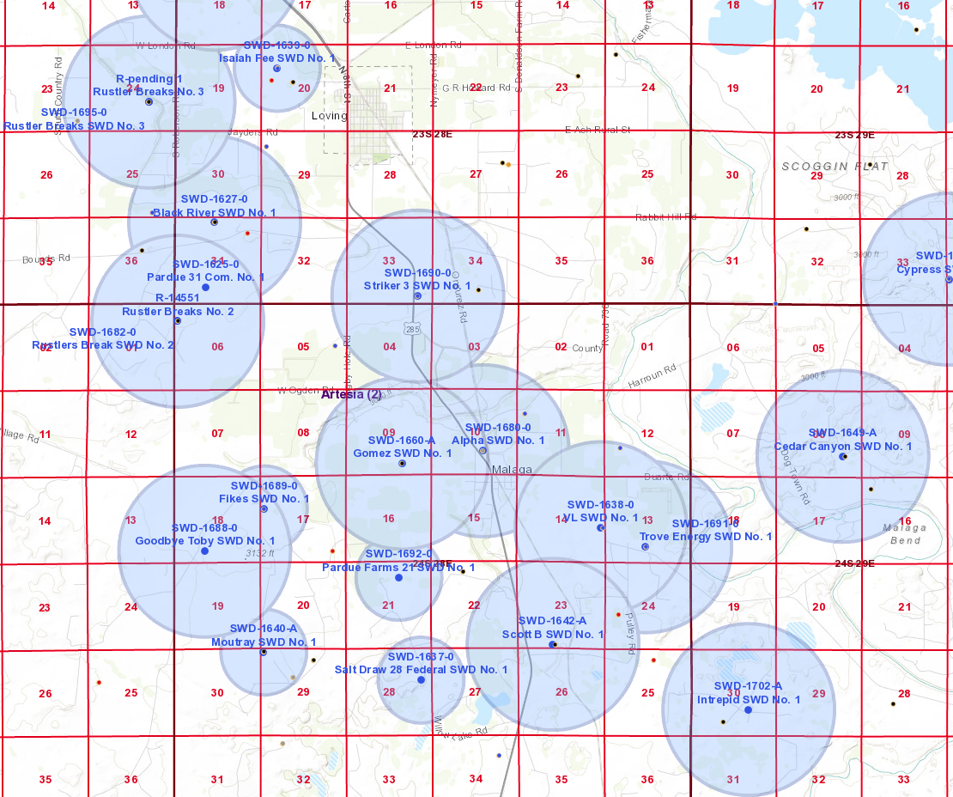
Recent Developments in Disposal Activities in Southeast New Mexico
Devonian and Silurian Disposal Wells
The effort to utilize deeper Devonian SWD wells have resulted in concentration of applications and approved orders for injection in the vicinity of the Purple Sage pool especially between Loving and Malaga.
The Division is approving orders with the intent to spread out disposal wells as to limit impacts to the disposal interval and extend the operational life of these wells

Slide 15
Recent Developments in Disposal Activities in Southeast New Mexico
Devonian and Silurian Interval
In 2015, the USEPA issued it findings of the UIC Technical Workgroup on minimizing the potential impacts of injection-induced seismicity.
The Division considered these findings and noted the growth Devonian SWD wells increased a potential for effects of pressure activating pre-existing stresses in the Pre-Cambrian or “basement” rocks.
As a result, the Division enacted a moratorium on any new injection below the top of the Ordovician System. This is an effort to isolate injection from the Devonian SWD wells from deeper migration by using the Ordovician formations as a lower confining zone or “buffer”.

Slide 16
Recent Developments in Disposal Activities in Southeast New Mexico
Devonian and Silurian Interval and Induced Seismicity
The Division also required supplemental information to be added to an application for a deep Devonian SWD well that would consider the overall seismic potential for the life of the disposal well.
This assessment was to be based on current models offered by academic or governmental agencies using both publicly-available data or proprietary data such as deep 3-D seismic.

Slide 17
Recent Developments in Disposal Activities in Southeast New Mexico
Efforts to Address to Disposal in the Southeast
  The Division is cooperating with NMOGA and other stakeholders in an effort to study and to produce a plan for further disposal in the Delaware Mountain Group including limitations on location, on disposal pressures, and on type of disposal operation.
  The Division is also reviewing the application process for “large-capacity”, deep Devonian SWD wells in an effort to maximize these type of wells with reduced potential for future issues such as induced seismicity or significant reservoir pressure increases.
Efforts to Increase Alternatives to Disposal
  Recycling
  Treatment

Slide 18
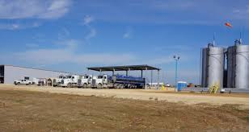
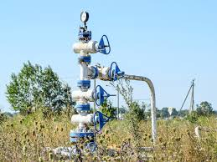
Recent Developments in Disposal Activities in Southeast New Mexico
Comments or Questions

