Slide 1
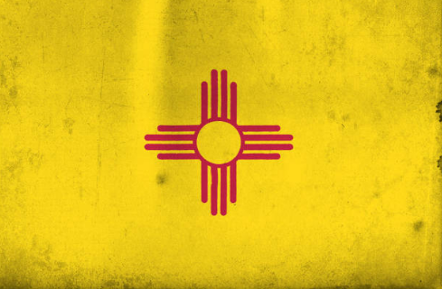
Energy, Minerals & Natural Resources Dept.
Ken McQueen - Cabinet Secretary
Matthias Sayer - Deputy Cabinet Secretary
Heather Riley – Director OCD
Produced Water Challenges and Solutions
2020…2025…

Slide 3
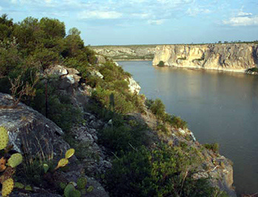
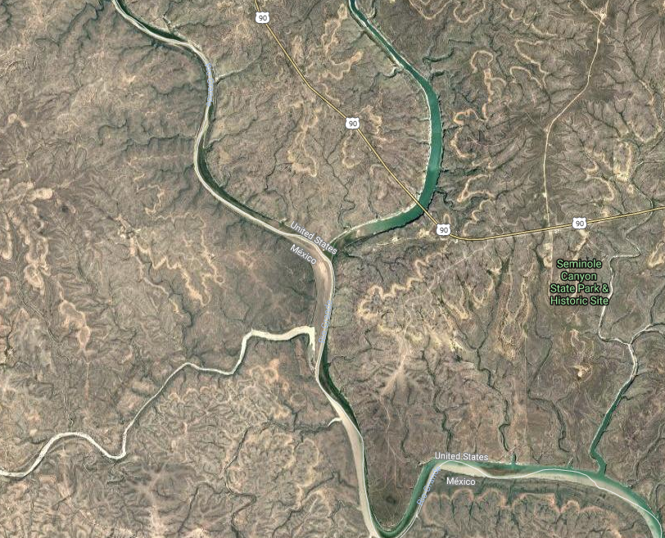
NM Water Confluences
Permian Operations consume water—how much??
Permian Region and NM are water short.
Permian operations produce water.
A + B + C = opportunity

Slide 4
New Mexico Water Use
Total: 3,815,971 af (2010)
Irrigated Agriculture
79% (3,000,155 af)
Domestic 0.8%
Livestock 1.1%
Public Water Supply 8%
Reservoir Evaporation 6.9%
Commercial 1.4%
Power 1.5%
Industrial 0.3%
Mining 1.1%

Slide 5
Aggregate 3.8%
Industrial 2.5%
Coal 2.3%
Potash 22%
Mining: (1.1%) 41,559 af
Metals 64%
26,598 af
Oil & Gas 5.4% 2,244 af

Slide 6
Compared measly piddly meager trivial meaningless literal drop in the bucket Why are we even talking about this??
0.06% of total NM water consumption!!

Slide 8
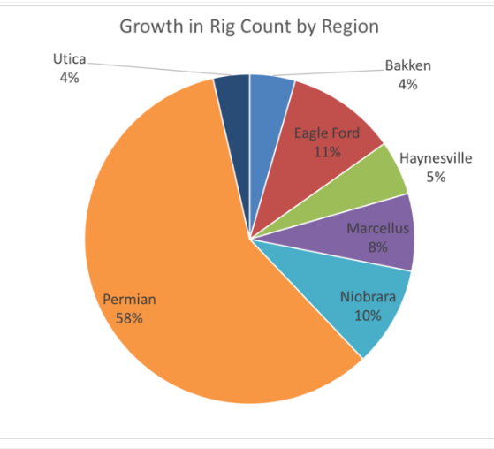
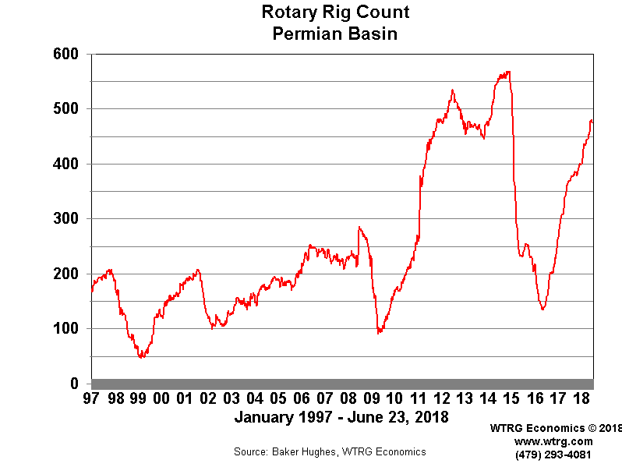

Slide 9
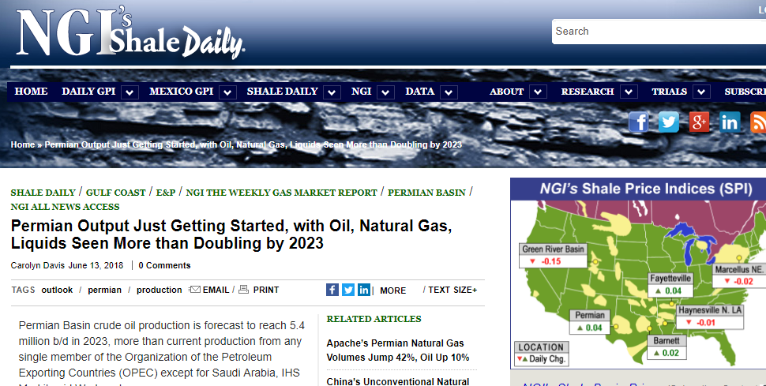
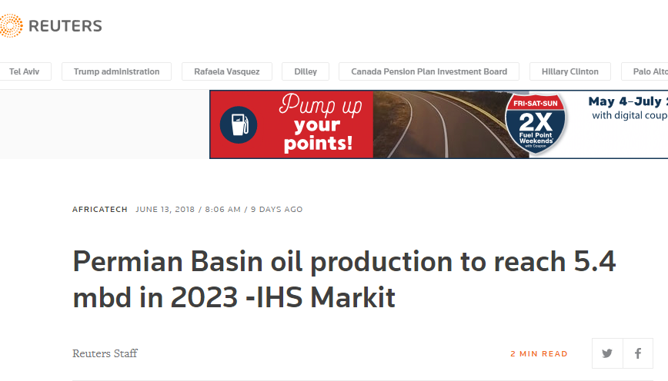
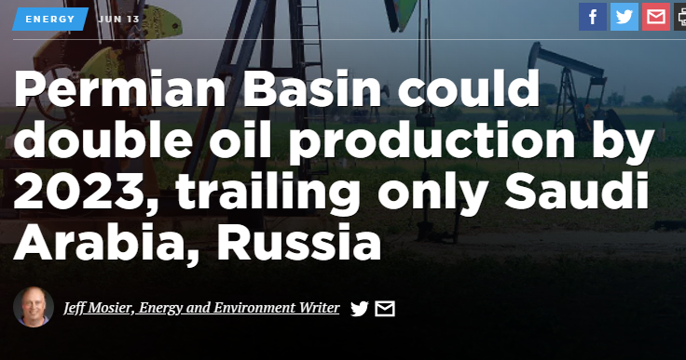

Slide 10
The Permian
World’s most strategically important oil producing region
Oil Production: 6MMBD by 2025
≈ 6% of global oil production
≈ 40% of U.S. oil production
≈ 12% compounded annual growth in NM Permian production 2018 to 2025
Gas production: >15 bcf/d by 2025
NGL production: ≈ 2.5MMBD by 2025

Slide 11
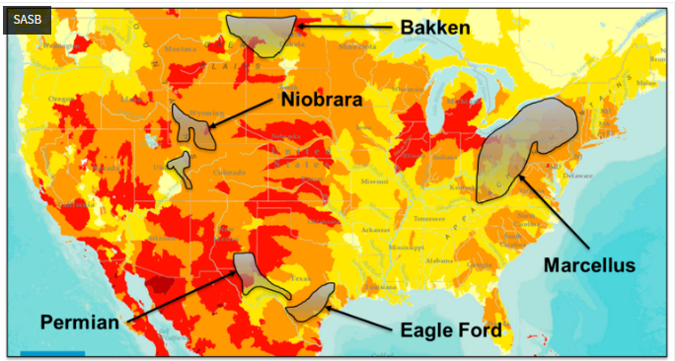
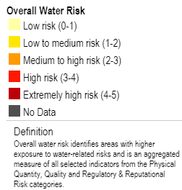
Analysts on Water Risk
Risk/stress varies by region
Marcellus:
low
Bakken
low to medium/high
Permian
medium to high/very high
“investors should consider a key nuance with respect to water usage — specifically, water withdrawals from high water-risk areas”

Slide 12
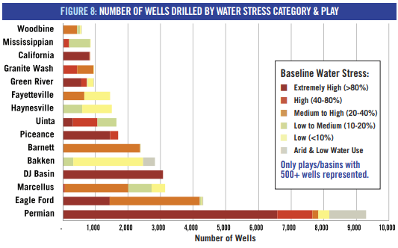
> 36% of hydraulically fractured wells in he U.S. overlay regions experiencing groundwater depletion
> 70% of the Permian’s wells are located in areas of extreme water stress

Slide 13
“Water-to-oil ratios not only increase over time, but can easily exceed 7:1, making it one of the highest water cut plays in the Lower 48…”
“Produced water has created an impending supply risk to the overall Permian region because escalating costs will raise breakevens…”
“The total volume of produced water is expected to grow by several million barrels over the next five years and the low cost, simple solutions will become exhausted…”

Slide 14
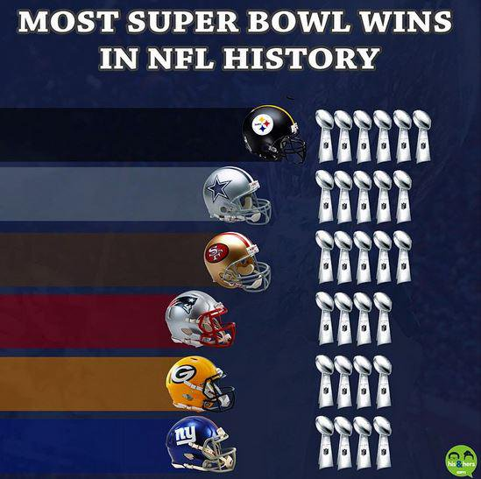
Defense doesn’t win championships
Freakonomics did the math:
In almost 10,000 regular season games, the better defensive team has won 66.5 percent of the time compared with 67.4 percent of the time for the better offensive team. That’s a slight nod to the offense but a negligible difference.
427 NFL playoff games over the last 45 seasons. The better defensive teams have won 58 percent of them. The better offensive teams have won 62 percent of the time. (Again, the winning team is sometimes better both offensively and defensively, which explains why the total exceeds 100 percent.) That’s a slight edge to the offense, but again, pretty even.
Among the 45 NFL Super Bowls, the better defensive team — measured by points allowed that season— has won 29 times. The better offensive team won 25 times. (Note that adds up to 53, which means that some teams are the better offensive and defensive team in the Super Bowl. Nineteen Super Bowls have featured a team superior on both sides of the ball. Those teams have won 14 of those games.) It’s a slight edge for defense, but it’s a pretty close call and not different from random chance
Bottom line: Defense is no more important than offense. It’s not defense that wins championships . . . you need either a stellar offense or a stellar defense, and having both is even better!

Slide 15
“It is unfortunate when men cannot, or will not, see danger at a distance; or seeing it, are restrained in the means which are necessary to avert, or keep it afar off … offensive operations, often times, is the surest, if not the only (in some cases) means of defence”
G. Washington

Slide 18
2025 Produced Water Scenario
6MM Bbls Oil
1 to 7 Water Oil Ration
6 MM BBls Oil * 7 MM Bbls water = 42 MM Bbls water
42 MM Bbls water * 365 = 15,330,000,000 Bbls / yr
1,997,931 acre feet / yr
2 MILLION ACRE FEET OF NEW WATER

Slide 19
Compared measly piddly meager trivial meaningless literal drop in the bucket Why are we even talking about this??
52% of total current NM water use!
0.06% of total NM water consumption!!

Slide 20
2 Million Acre Feet =

Slide 21
The Opportunity
“In New Mexico’s arid environment, conserving our resources by recycling produced water for more beneficial uses presents a significant economic development and water supply opportunity,”
said New Mexico Energy, Minerals and Natural Resources Department Cabinet Secretary Ken McQueen.
“For years New Mexico has advocated recycling of produced water in oil and gas completion activities. Continued collaboration with EPA on this issue will no doubt encourage even greater recycling and additional reuse opportunities.”

Slide 22
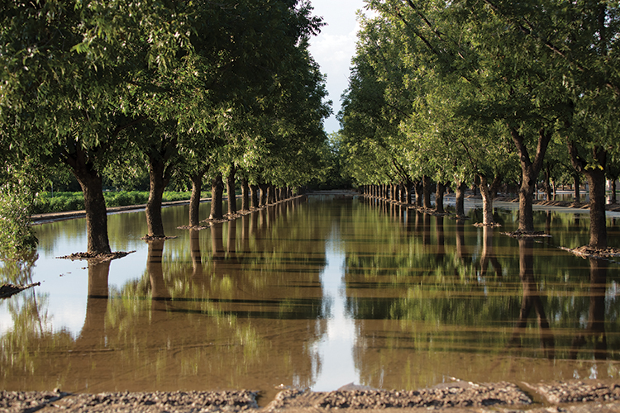
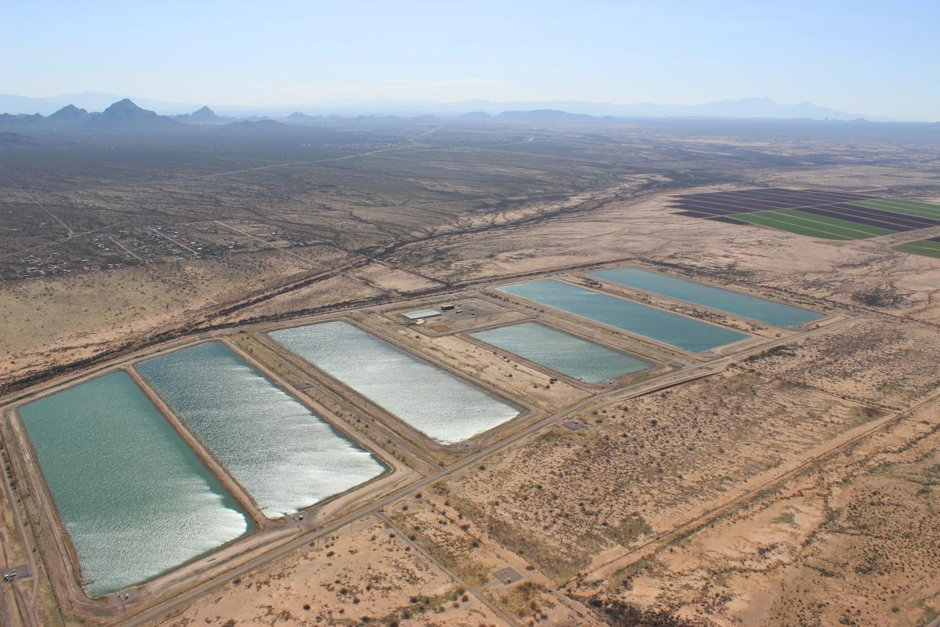
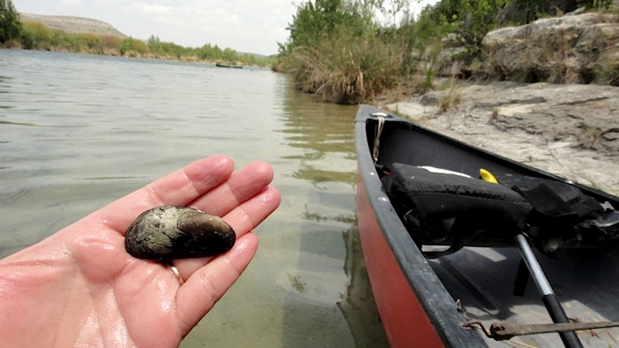
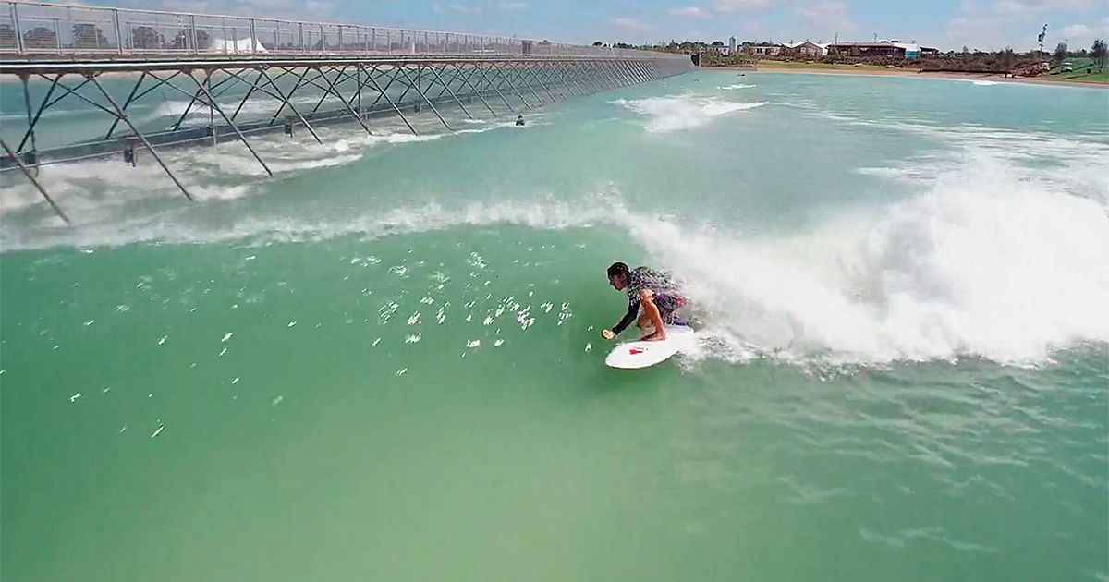
The Opportunity
Ag water
Stock watering
Irrigation
Threatened and Endangered Species mitigation flows
Municipal water
Groundwater recharge
Economic development / Value-added industry
Manufacturing
Interstate and international water obligations
Inter-basin transfers
Water park
Surf park

Slide 23
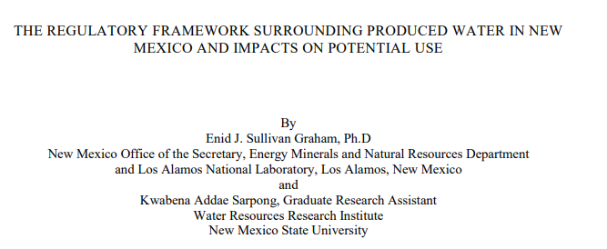
Jeri Sullivan Graham
What is the State doing?

Slide 24
NM Regulatory Snapshot
Oil and Gas Act places certain authority over produced water at OCD
PW = “water that is an incidental byproduct from drilling for or the production of oil and gas” (NM Stat. 70-2-33(K)).
“No permit shall be required from the state engineer for the disposition of produced water . . .” (NM Stat. 70-2-12.1).

Slide 25
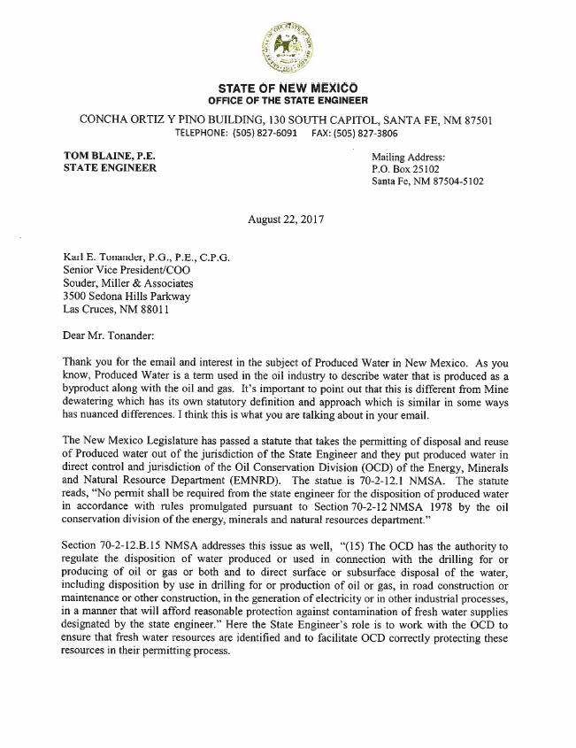
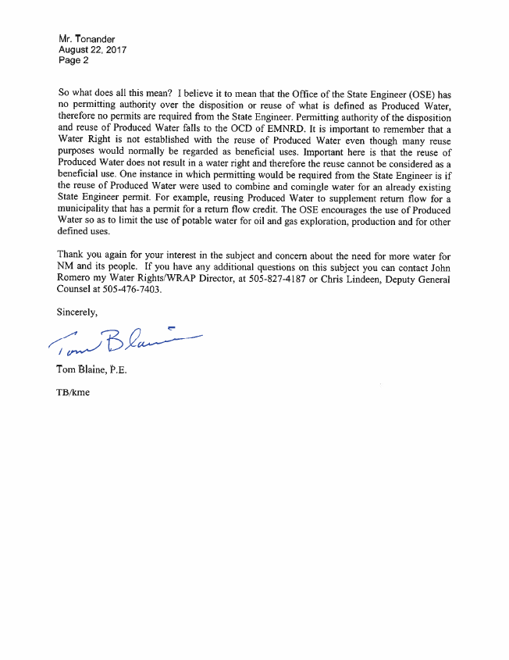
“So what does this all mean? I believe it to mean that the Office of the State Engineer (OSE) has no permitting authority over the disposition or reuse of what is defined as Produced Water, therefore no permits are required from the State Engineer”
“Important here is the reuse of PW does not result in a water right and therefore the reuse cannot be considered as a beneficial use.”
“One instance in which permitting would be required from the State Engineer is if the reuse of PW were used to combine and comingle water for an already existing OSE permit.”

Slide 26
NM Regulatory Snapshot
OCD regulates the use and certain dispositions of produced water
SWD / Injection (19.15.26 NMAC);
Pits, below grade tanks, closed-loop systems (19.15.17 NMAC);
Recycling facilities (19.16.34 NMAC);
Surface waste management facilities (19.15.36 NMAC).

Slide 27
NM Regulatory Snapshot
Rule 34 encourages recycling
“To encourage the recycling, re-use or disposition of produced water …”
“No permit or registration is required . . . for the disposition by use of PW for drilling, completion, producing, secondary recovery . . .”
“Any other use of PW requires prior approval . . .”

Slide 28
NM Regulatory Snapshot
Discharge—NMED / EPA
NMED does not have CWA Section 402 primacy
EPA issues NPDES permits in NM
See 40 CFR Parts 122 – 125, 403, 435
May 2018 Administrator Pruitt announced new EPA study examining how EPA, states, and stakeholders regulate and manage PW.

Slide 29
NM Regulatory Snapshot
EPA / State examination
EPA focusing on available approaches to manage PW, answer questions:
How federal approaches under the CWA can interact more effectively with state regs, requirements, policy needs
Whether adjustments to federal regulations are necessary and appropriate

Slide 30
NM Regulatory Snapshot
EPA / State examination
Joint New Mexico / EPA white paper re federal and state regulatory landscape & opportunities

Slide 31
Policy Questions
Who owns PW?
Liability vs asset
PW does not fit in the Prior Appropriation paradigm
Not public trust water
Water right = real property right
No water right = no real property right
PW as personal property
Is it the operator’s?
Is it the surface owners?
Is it the mineral owners?

Slide 32
Water Confluences
Permian operations consume water
Permian region is water short
Permian produces water
Permian-sized opportunity to turn on the water

