Slide 1
Occidental Petroleum Overview
Jeff Bennett, President and General Manager – New Mexico Delaware Basin
June 27, 2017, New Mexico EnergyPlex Conference – Hobbs, New Mexico

Slide 2
Occidental in the Permian Basin/Highlights

Slide 3
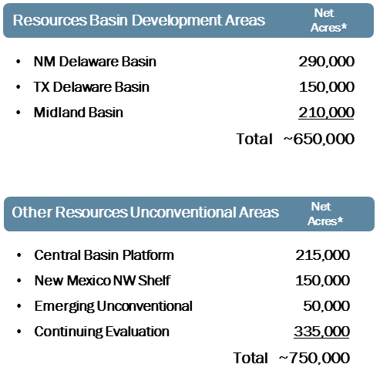
Permian Basin Highlights 2016 Oil and Gas Performance
Permian Resources
Growth-oriented unconventional opportunities with approximately 1.4 million net acres
Fastest-growing asset with over 11,650 drilling locations in its horizontal drilling inventory focused in Midland and Delaware basins; average lateral length increased 20% to approximately 7,100 feet
Production averaged 124,000 BOE per day, a 13% increase from 2015
Reserve replacement rate of approximately 290%; finding and development costs at historic low of $9.00 per BOE
Permian EOR
Utilizes enhanced oil recovery techniques such as CO₂ floods and waterfloods with approximately 1.1 million net acres
Production averaged 145,000 BOE per day
Nearly three-quarters of production comes from fields that actively employ CO₂ flooding
Injects approximately 2.0 billion cubic feet of CO₂ per day into oil reservoirs, making Occidental the largest CO₂ injector in the Permian Basin and among the largest globally
Notes:
Occidental manages operations in the Permian through two businesses:
Permian Resources, which consists of growth-oriented and unconventional opportunities, and is among our fastest-growing assets and
Permian EOR, which uses enhanced oil recovery techniques such as carbon dioxide floods and water floods.
This combined portfolio of unconventional and conventional acreage differentiates us from our competitors and provides valuable growth.
Our PR business has the ability to add unconventional, short-cycle production at high rates, while Permian EOR provides reliable production and steady cash flow.
(Source: Oxy 101)

Slide 4
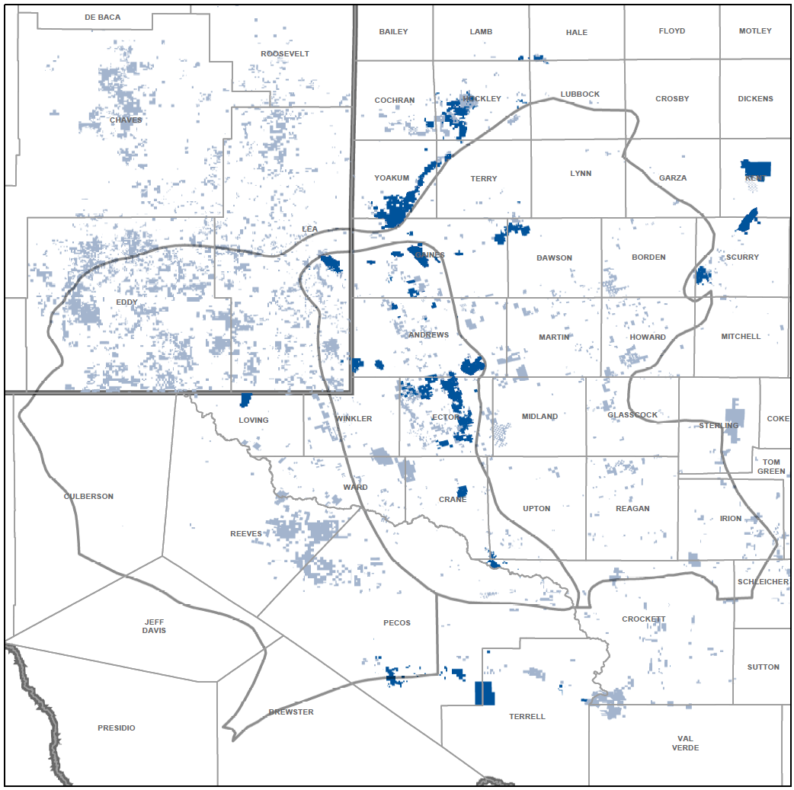
Permian Resources
Focused Development
Contiguous Acreage
Multi-bench
Capable Infrastructure
Valuable Growth
New Mexico NW Shelf
Greater Sand Dunes – 2,000+ Locations
Midland Basin
NM Delaware Basin
TX Delaware Basin
Central Basin
Platform
Greater Barilla Draw – 5,000+ Locations
Permian Resources Acreage
Permian EOR Acreage

Slide 5
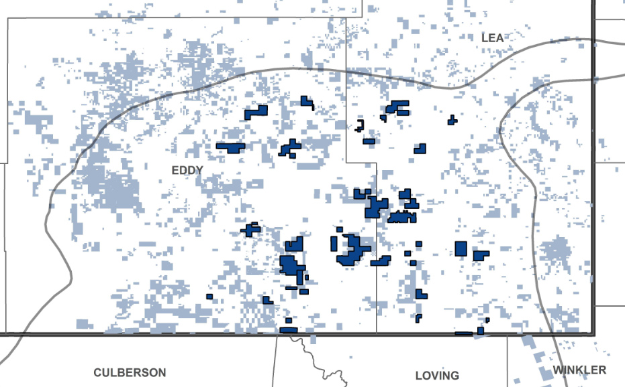
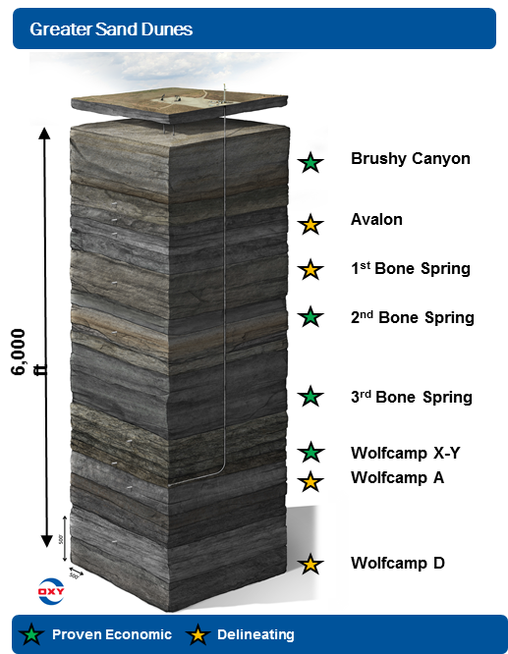
Permian Resources
New Mexico
Contiguous Acreage
Multi-bench
Capable Infrastructure
Valuable Growth
New Mexico Business Plan…
Range of Rig Count
Annual Spend
3 Yr

Slide 6
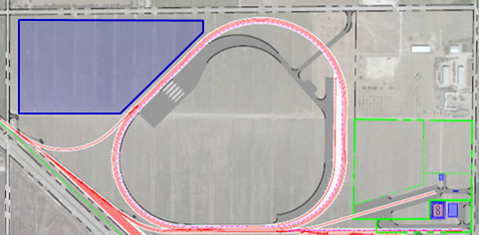
Logistic & Maintenance Hub Underway
Secures supply availability
$500 – $750k savings per well
Below market cost of supply will offset potential service cost inflation
Reduces last mile logistics costs
Mutually beneficial partnerships
Value Chain Partnerships Lower Costs
Service company yard
Maintenance
Stimulation & Cement
Service directional tools
OCTG Laydown Yard
~20 railcar spots
Dedicated truck entry/exit
Staging, returns, reclamation
Strategically located in New Mexico
244 acres
3 unit train loop
30,000 tons of sand storage
Supports 10-12 rigs/year
Operational in early 2018
Sand Transload and Storage
6 Silos
3 Unit train loops
Transload capacity
OxyChem Acid Facility
Transload, storage, and dilution of HCI for fracs
~20 rail transload capacity
Notes:
Technology isn’t just about the latest techniques or tools, though.
It’s also about application and we’re using technology to make our supply chain more efficient.
That means cost-savings and better relationships with our service companies.
Our logistics and maintenance hub located in Eddy County, New Mexico, features a transloading facility capable of handling 3 unit
trains of frac sand with 30,000 tons of storage capacity. In addition to frac sand, the logistics hub is also designed to handle hydrochloric acid from
OxyChem, oil country tubular goods and to provide a base for maintenance and support of strategic drilling and completion services. This project
represents alignment of top-tier industry partners leveraging their strengths to remove cost inefficiencies from the overall value chain. In addition
to economic benefits, this approach provides us with a secured supply of critical materials as well as distribution channels. With sand supply
tightening and existing terminal space being contracted, this project secures OXY's ability to execute our development program in Southeast New
Mexico without concern for scarcity of supply. This provides OXY the benefit of backward integration, with each partner managing their corresponding
core businesses to remove the operational and business risk associated with the conventional vertical integration model. Based on the win-win
value assessment for OXY and our partners, we're evaluating options for additional logistics and maintenance hubs in Greater Barilla Draw and the
Midland Basin. Our efforts in the Permian Basin are a clear example of how through differentiated, value-based approach generates growth and
value through a sustainable competitive advantage and differentiates us from our peers.
Source: Q1 2017 Earnings

Slide 7
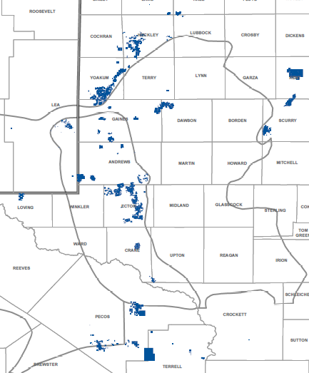
Permian EOR
Significant inventory in 10-year plan
Geographically diverse
100 active CO₂ + water floods covering multiple horizons
2 BBOE of identified net resource potential
870 net MMBOE at
< $6.00 Future Development Cost
Proven Leader in Maximizing Recovery Across the Permian
Permian EOR
Net Resource Potential
MMBOE
High-gradable Inventory
Midland Basin
Delaware Basin
TZ/ROZ*
Water Floods + Other Infill Drilling Opportunities
Central Basin
Platform
CO₂ Floods
Permian EOR Acreage
<$6
<$10
Future Development
Cost ($/BOE)
*Note: TZ/ROZ – Transition Zone and Residual Oil Zone
Notes:
Grayburg – San Andres
Glorieta
Clearfork
Wichita/Abo
Canyon – Strawn
Devonian

Slide 8
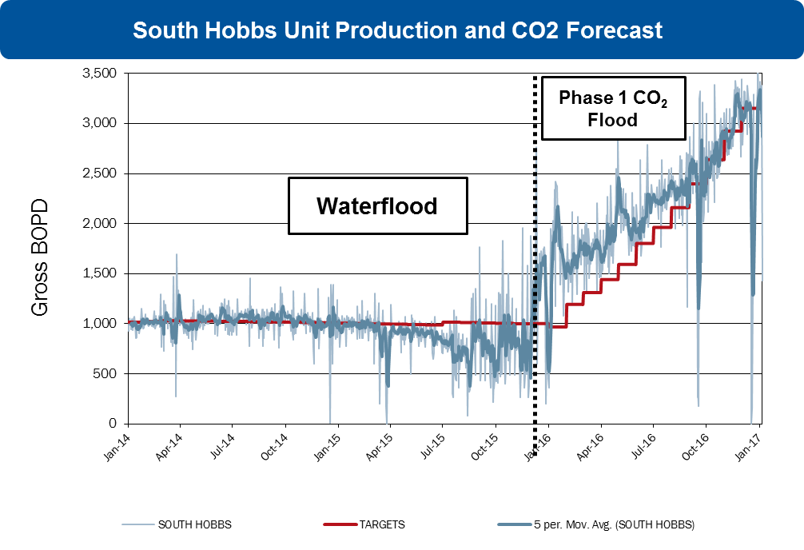
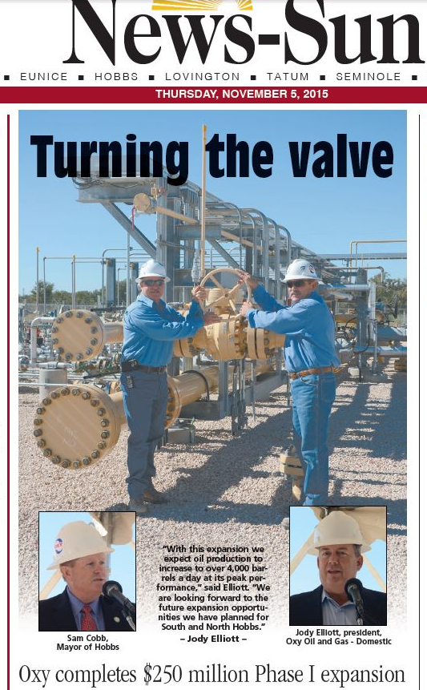
Permian EOR
2017 Capital Outlook
CO₂ Floods / Expansions - $195MM
TZ / ROZ Projects - $50MM
Gas Processing Capacity - $50MM
Water Flood and Infill Drilling - $30MM
Non-operated + Maintenance - $135MM

Slide 9
Occidental Petroleum
Forward-Looking Statements
Portions of this presentation contain forward-looking statements and involve risks and uncertainties that could materially affect expected results of operations, liquidity, cash flows and business prospects. Actual results may differ from anticipated results, sometimes materially, and reported results should not be considered an indication of future performance. Factors that could cause results to differ include, but are not limited to: global commodity pricing fluctuations; supply and demand considerations for Occidental's products; higher-than-expected costs; the regulatory approval environment; reorganization or restructuring of Occidental's operations, not successfully completing, or any material delay of, field developments, expansion projects, capital expenditures, efficiency projects, acquisitions or dispositions; uncertainties about the estimated quantities of oil and natural gas reserves; lower-than-expected production from development projects or acquisitions; exploration risks; general economic slowdowns domestically or internationally; political conditions and events; liability under environmental regulations including remedial actions; litigation; disruption or interruption of production or manufacturing or facility damage due to accidents, chemical releases, labor unrest, weather, natural disasters, cyber attacks or insurgent activity; failure of risk management; changes in law or regulations; or changes in tax rates. Words such as “estimate,” “project,” “predict,” “will,” “would,” “should,” “could,” “may,” “might,” “anticipate,” “plan,” “intend,” “believe,” “expect,” “aim,” “goal,” “target,” “objective,” “likely” or similar expressions that convey the prospective nature of events or outcomes generally indicate forward-looking statements. You should not place undue reliance on these forward-looking statements, which speak only as of the date of this presentation. Unless legally required, Occidental does not undertake any obligation to update any forward looking statements, as a result of new information, future events or otherwise. Material risks that may affect Occidental’s results of operations and financial position appear in Part I, Item 1A “Risk Factors” of the 2016 Form 10-K.

Slide 10
Thank you

