Slide 1
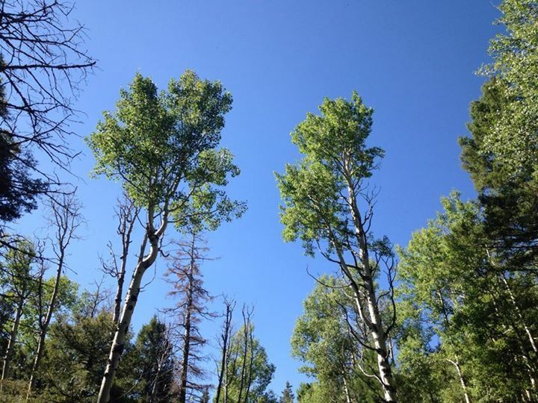

New Mexico
State Land Office
Commissioner Aubrey Dunn

Slide 2
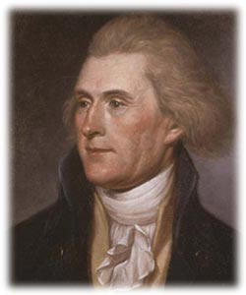
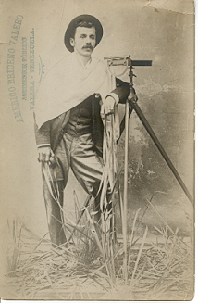
How Land Management Began
Thomas Jefferson proposed the Public Land Survey System that is used today.
This system incorporates a land survey that uses a mathematical rectangular grid applied to the land area. The grid designation was based on a standard unit marker placed on the ground.
This was the basis of the General Land Ordinance of 1785, which established the present land survey system and charted Western history of the U.S.

Slide 3
History
Trust lands were granted to New Mexico by Congress under the Ferguson Act of 1898 and the Enabling Act of 1910. The latter Act allowed New Mexico’s admission to the United States upon voter approval of the state constitution.
The state was granted four square miles – Sections 2, 16, 32, and 36 – in each 36 section township.

Slide 4
State Land Office
Today, the State Land Office manages 9 million acres of surface estate and 13 million mineral acres held in trust for public schools, universities, hospitals, correctional facilities, water projects and public building construction and repair.
The State Land Commissioner has a fiduciary responsibility to oversee the Trust and to manage the resources and assets of State Trust Lands to maximize revenue for the beneficiaries.

Slide 5
















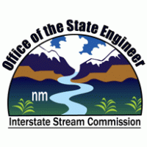


State Land Trust Beneficiaries
Saline Lands
Water Reservoirs and
Rio Grande Improvements
Common Schools
Charitable, Penal & Reform

Slide 6
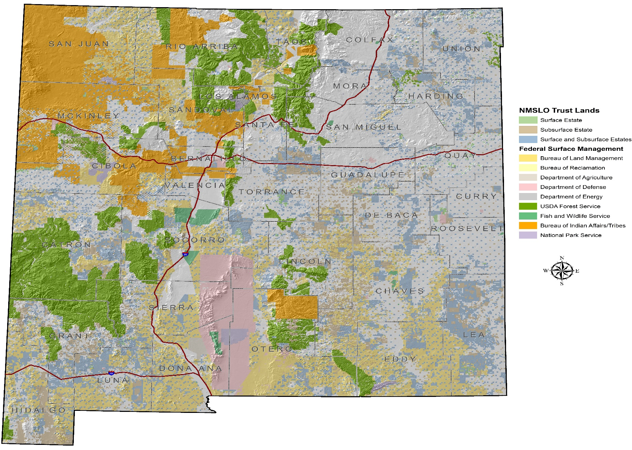
Land Status Map

Slide 7
Two Funds: LMF and LGPF
Land Maintenance Fund
This fund is generated by revenue from renewable resources, such as agricultural and commercial leases, rights-of-way and interest. Oil, gas and mineral bonuses from lease sales also contribute to this fund.
The Land Office’s operating budget is paid from this fund and the remaining balance is distributed proportionately to the beneficiaries.
Land Grant Permanent Fund
This fund receives royalty payments from non-renewable resources, such as oil, gas and mineral extraction and land sale proceeds.
Since 1959, the State Investment Council (SIC) has managed the fund. The SIC, of which the Commissioner is a member, invests the corpus of the fund.
The SIC also distributes revenue to the beneficiaries monthly, based on Constitutional provisions and the beneficiaries proportionate share.

Slide 8
State Land Office Revenue Flow FY 2017 (est.)
Land Maintenance Fund
Renewable Resources
(Leases, Rights-of-Way and
Interest)
$ 98.4 Million (est.)
Land Office Operating Expenses
$15.9 Million (est.)
Beneficiary Distribution
$82.5 Million (est.)
Total Revenue – All Sources
$548.4 Million (est.)
Total Projected Distributions
$720.6 Million
Land Grant Permanent Fund
Non– Renewable Resources
(Royalties and Land Sale
Proceeds)
$450 Million (est.)
LGPF is Managed by the State Investment Council
$15.6 Billion
Ending Market Value as of 2/28/17
Beneficiary Distribution
$638.1 Million (est.)
Percent of 5-year average
ending market value

Slide 9
State Land Office – Revenue Sources
Revenues by Source
Resources | FY 2015 | FY 2016 | YTD FY 2017 (7/1/2016-4/30/2017)
Mining | $ 136,868 | $ 519,409 | $ 65,784
Rights-of-Way | $ 6,795,595 | $ 12,373,622 | $ 7,129,435
Grazing | $ 7,280,752 | $ 8,635,845 | $10,717,577
Renewable Energy | $ 309,218 | $ 1,016,587 | $ 118,456
Business Leases | $ 10,390,897 | $ 10,489,073 | $ 5,663,464
Oil and Gas | $ 44,200,957 | $ 42,670,365 | $64,528,455
Fees, Interest | $ 1,063,218 | $ 1,532,373 | $ 2,235,351
Sub-Total | $ 70,177,505 | $ 75,704,901 | $90,458,522
Royalty | FY 2015 | FY 2016 | YTD FY 2017 (7/1/2016-4/30/2017)
Mining | $ 13,434,134 | $ 12,570,915 | $ 5,544,816
Oil and Gas | $ 653,482,767 | $ 406,273,449 | $ 353,097,608
Water | $ 2,449,425 | $ 900,085 | $ 459,117
Sub-Total | $669,366,326 | $ 419,744,449 | $ 359,101,541
Revenue Totals | $739,543,831 | $ 495,449,350 | $ 449,560,063

Slide 10
Revenue Breakdown
FY 2016 Revenues:
Oil & Gas: $448,943, 813
Minerals: 12,374,829
Grazing: 8,635,845
Commercial: 25,494,860
Fees, Interest: 1,532,373
Total: $497 million
$419.7 million was paid from the SLO into the LGPF.
$655,785,168 to the beneficiaries from LMF and LGPF.

Slide 11
Permian Basin Highlights
Covers 75,000 square miles in western Texas and southeastern New Mexico
More than ½ of the rigs added in the Basin are concentrated in five counties
  Reeves, Loving, Midland and Martin counties in Texas
  Lea County, New Mexico
Crude oil production is expected to increase to an estimated 2.4 million barrels per day
Between January 2016 and March 2017, oil production increased in all but three months, even as domestic crude oil prices fell.
Rig count in April 2017 was 340 or 40 percent of the total rigs in the United States
Recoverable reserves exceed
  20 billion barrels of oil
  16 trillion cubic feet of natural gas
  1.6 billion barrels of hydrocarbon gas liquids

Slide 12
Prolific Oil Production
EOG Well - Whirling Wind 11 Fed Com #704H
  Lea County
  Initial Production – 8,990 Barrels Per Day
  Current Production -6,230 Barrels Per Day
  Compared to Average Well Production - 600 Barrels Per Day

Slide 13
New Mexico Rig Count

Slide 14
State Oil Production – Past 36 Months

Slide 15
Revenue Processing Section: Royalty Processed Top Ten Producers
May 2017
TOP TEN

Slide 16
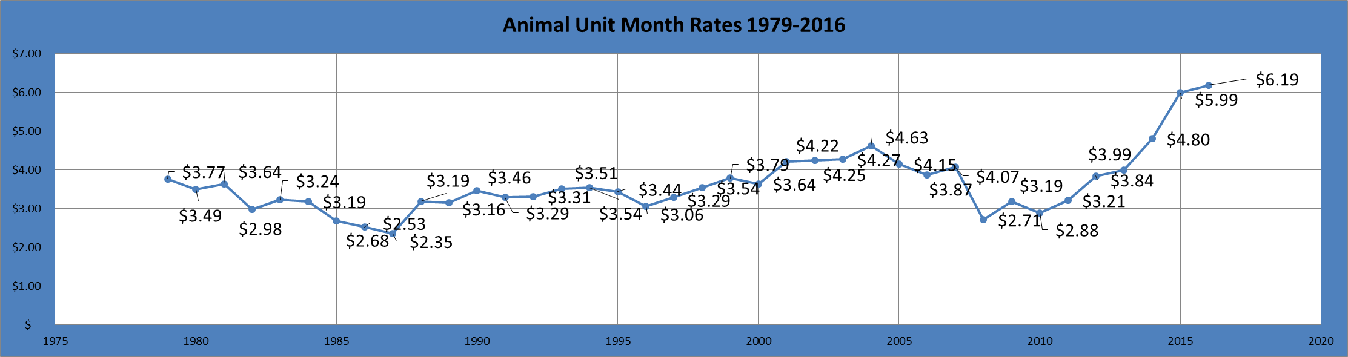
Grazing AUM Rates

Slide 17
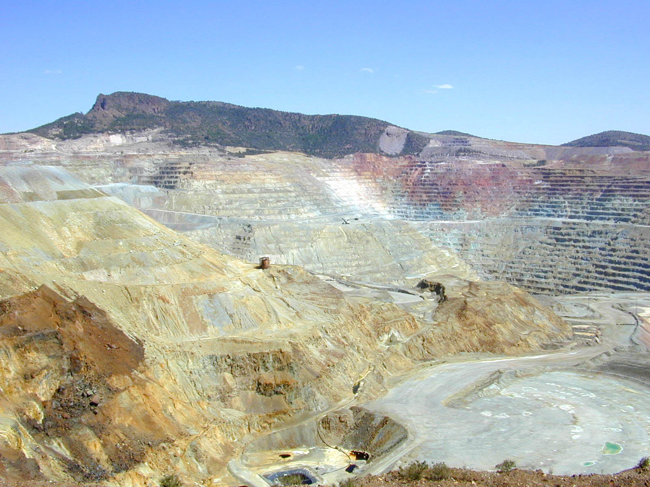
Green Energy = Zero Impact?
All energy sources have impacts.

Slide 18
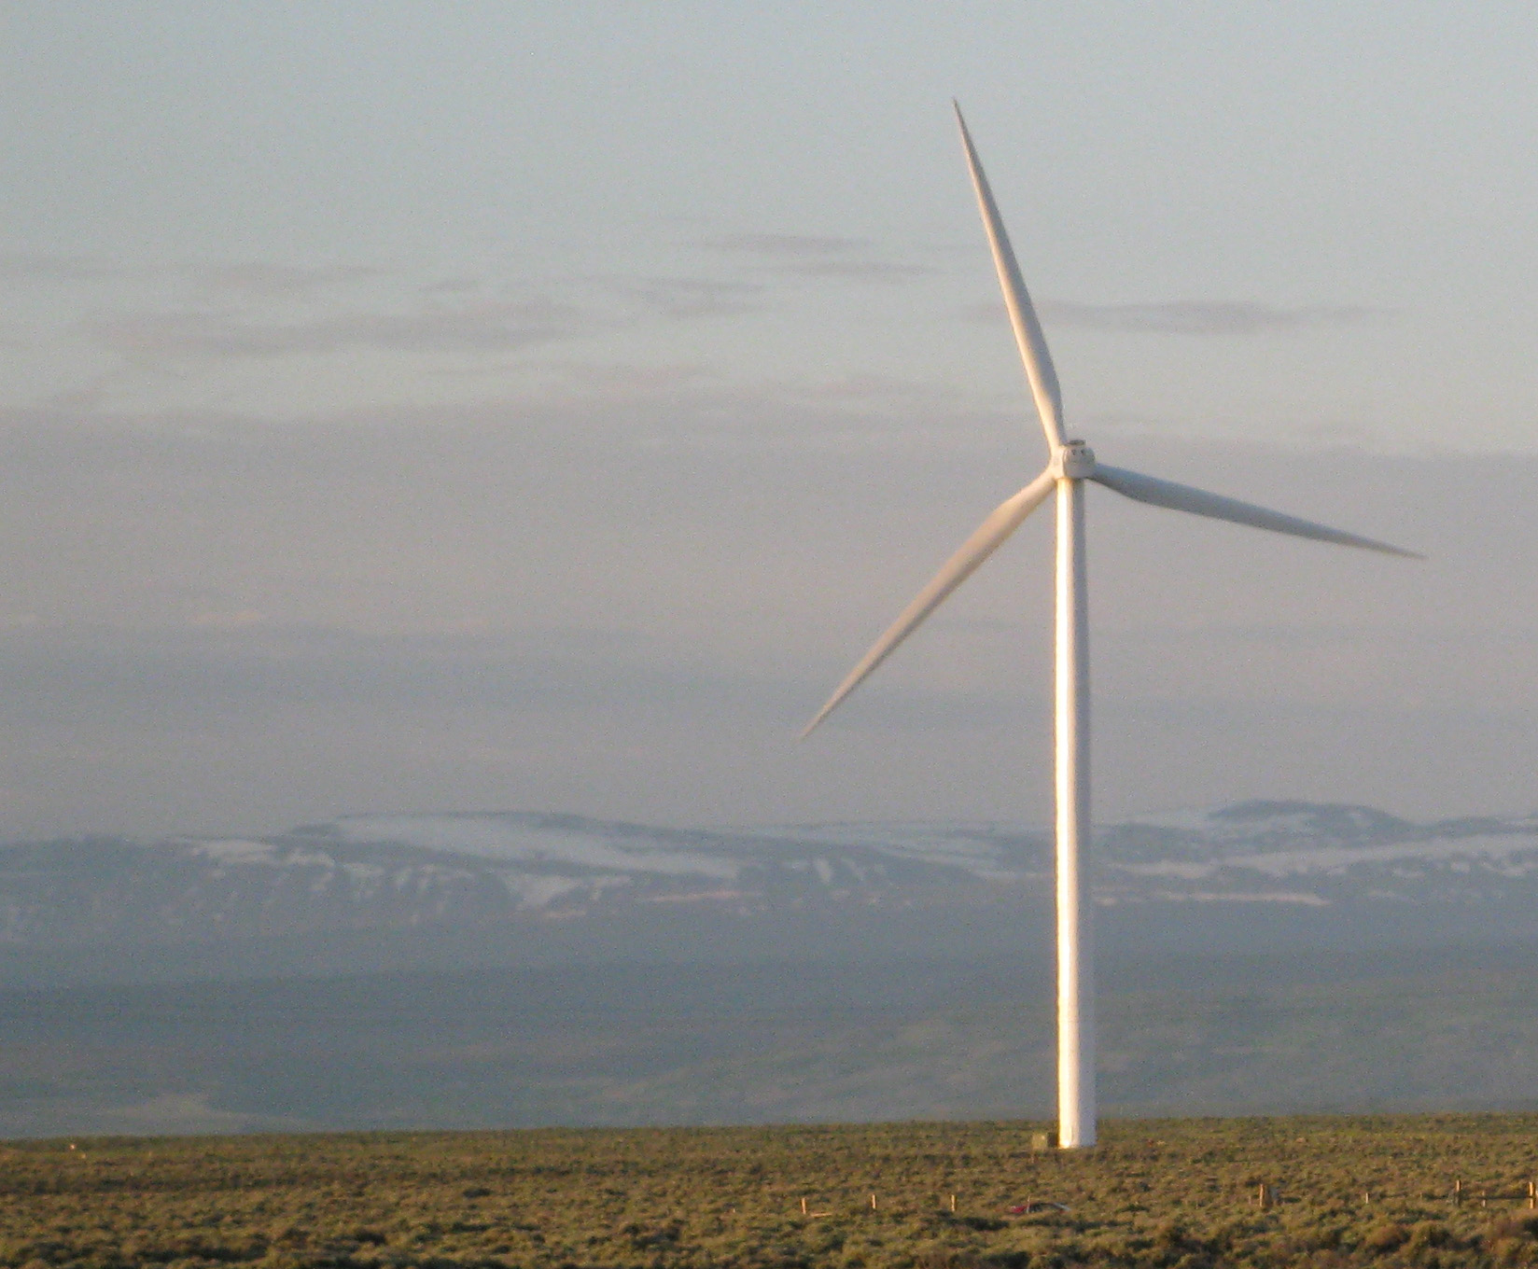
The reality…
One 3 MW wind turbine:
9.9 tons of copper
1,980 tons of rock mined just for the copper
A TOTAL of 1,788 tons of mined components for each wind turbine…not including transmission components!
OR, 3.7 million pounds of mined components for each wind turbine
Iron, concrete, silica, chromium, molybdenum, fluorspar, copper, nickel, neodymium, manganese, kaolin, colemanite, limestone, petroleum……plus the waste rock.

Slide 19

A status symbol unmasked…
6x more mined materials than a comparable gasoline vehicle…with much more eventual disposal impact

Slide 20
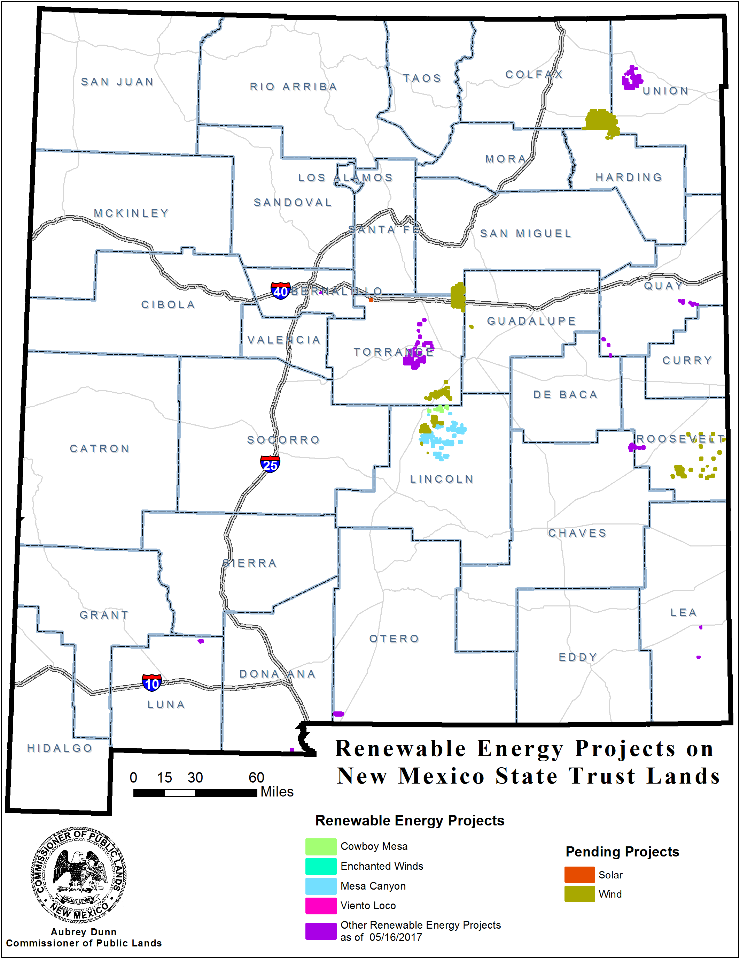
Renewable Energy Projects
Solar - Active: 6
  Pending: PNM
        Invenergy Solar
Wind - Active: 5
  Pending: GLL (Gladstone)
  Orion Wind
  Cowboy Mesa
  Viento Loco
  Enchanted Winds
  Mesa Canyons
  Sagamore
Total Megawatts: 10,595
Total Acres: 173,518

Slide 21
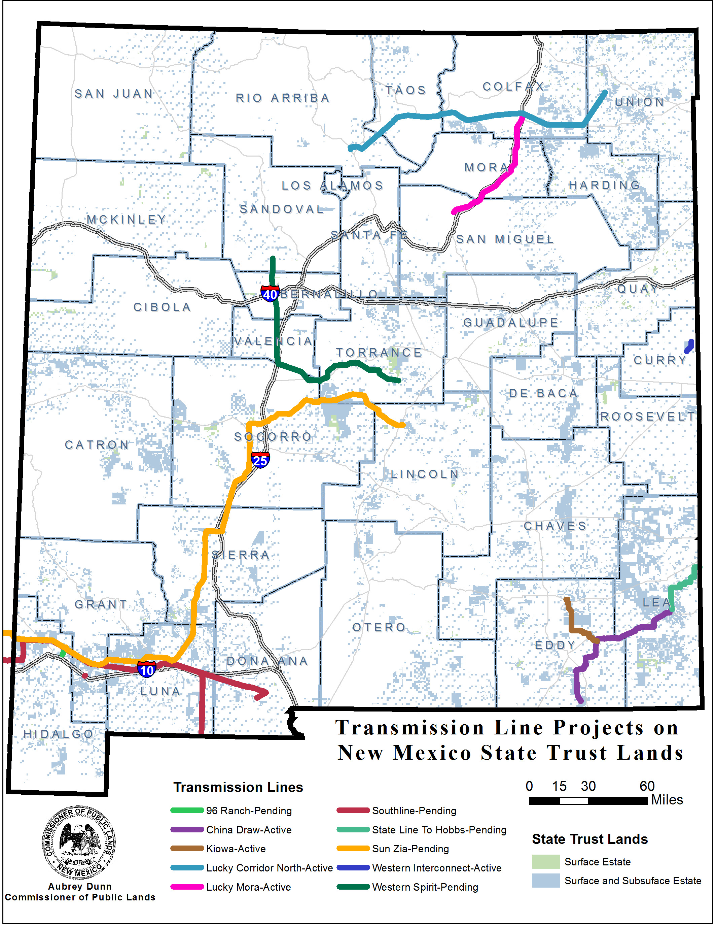
Transmission Line Projects:
Active
China Draw
Kiowa
Lucky Corridor North
Lucky Mora
Western Interconnect
Pending
96 Ranch
Sunzia
Southline
SPS – Hobbs to Stateline
Western Spirit (Cleanline)

Slide 22
State Trust Lands Restoration and Remediation Fund
House Bill 24 – the State Trust Lands Restoration and Remediation Fund.
  Overwhelming support, unanimously passed both chambers and signed by the governor.
Will allow funding for more rangeland, forest, illegal dump site clean up and watershed restoration projects on State Trust Lands across New Mexico.
Restoration and remediation projects in fiscal year 2018 could reach $2.4 million.

Slide 23
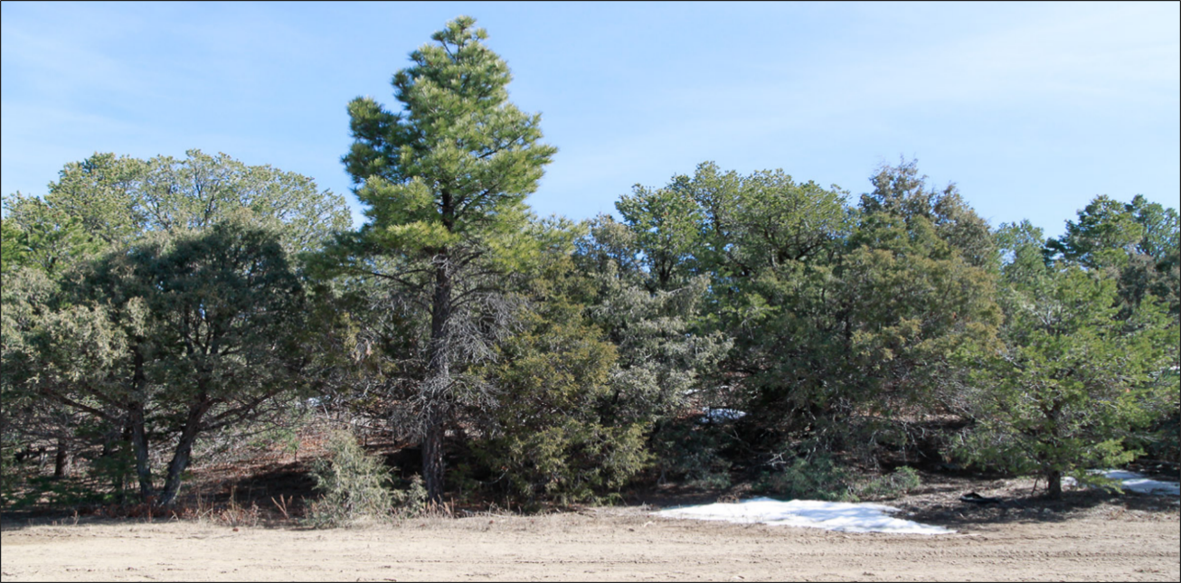
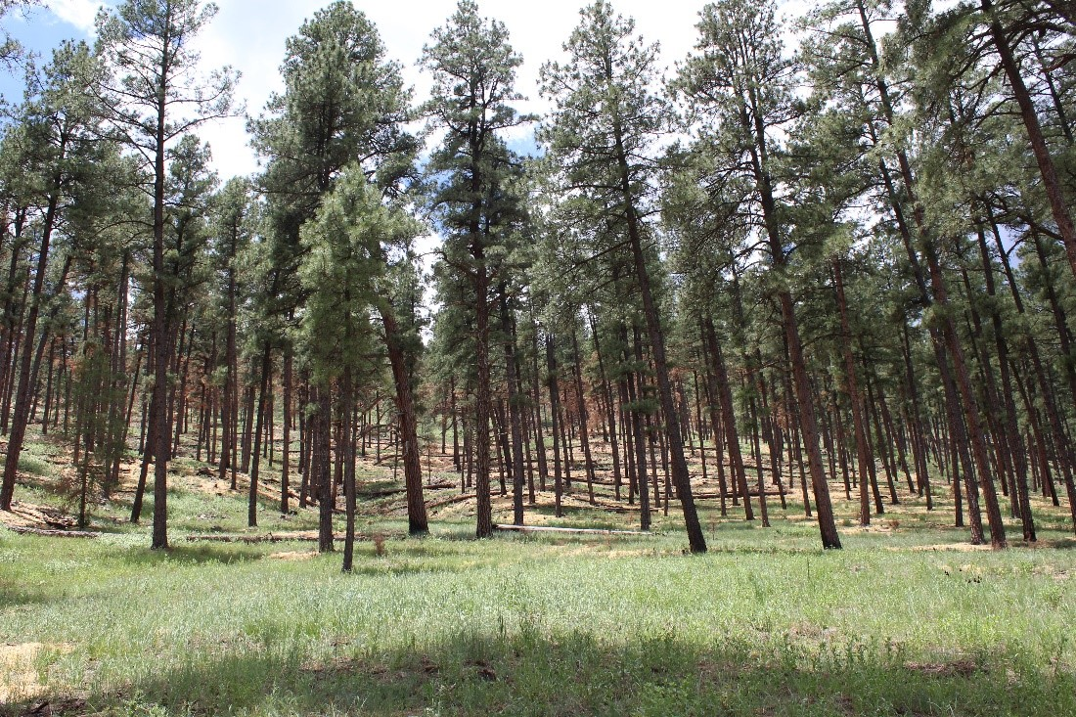
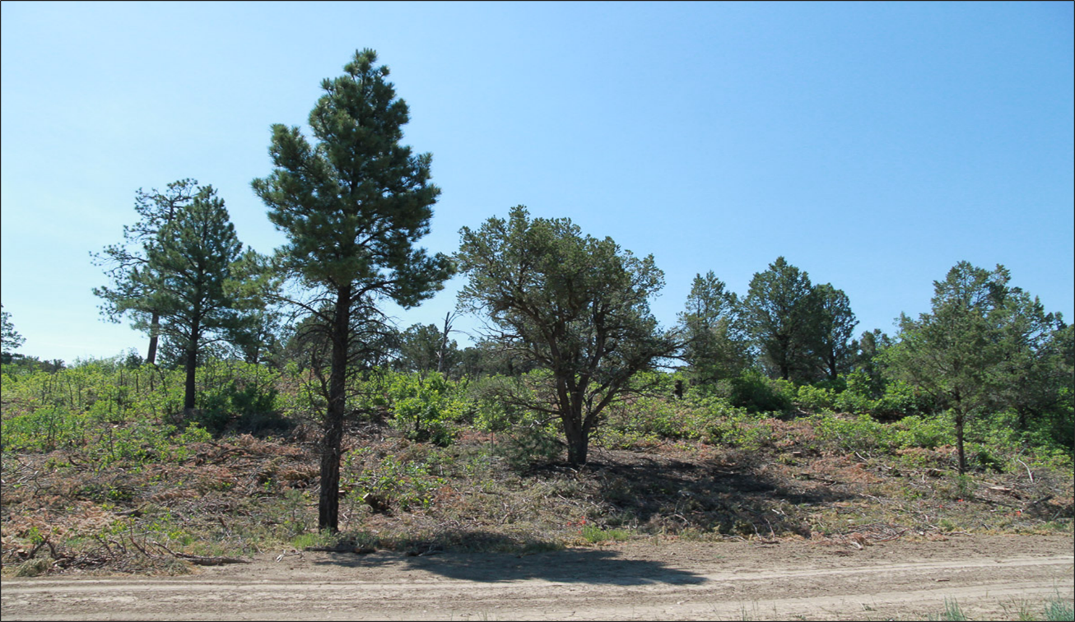
Moon Mountain
Flood Mitigation
Rio Nutrias Mastication Project
Before
After

Slide 24
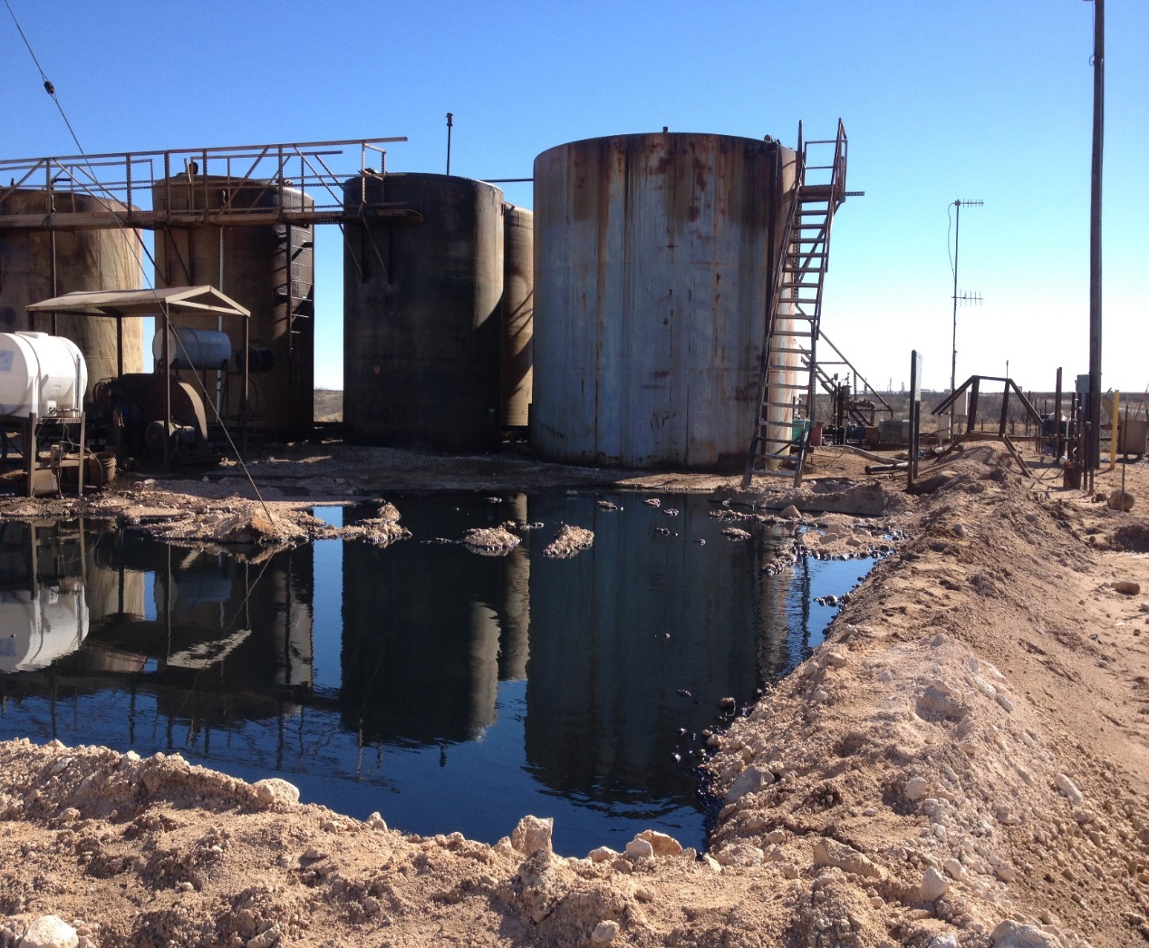
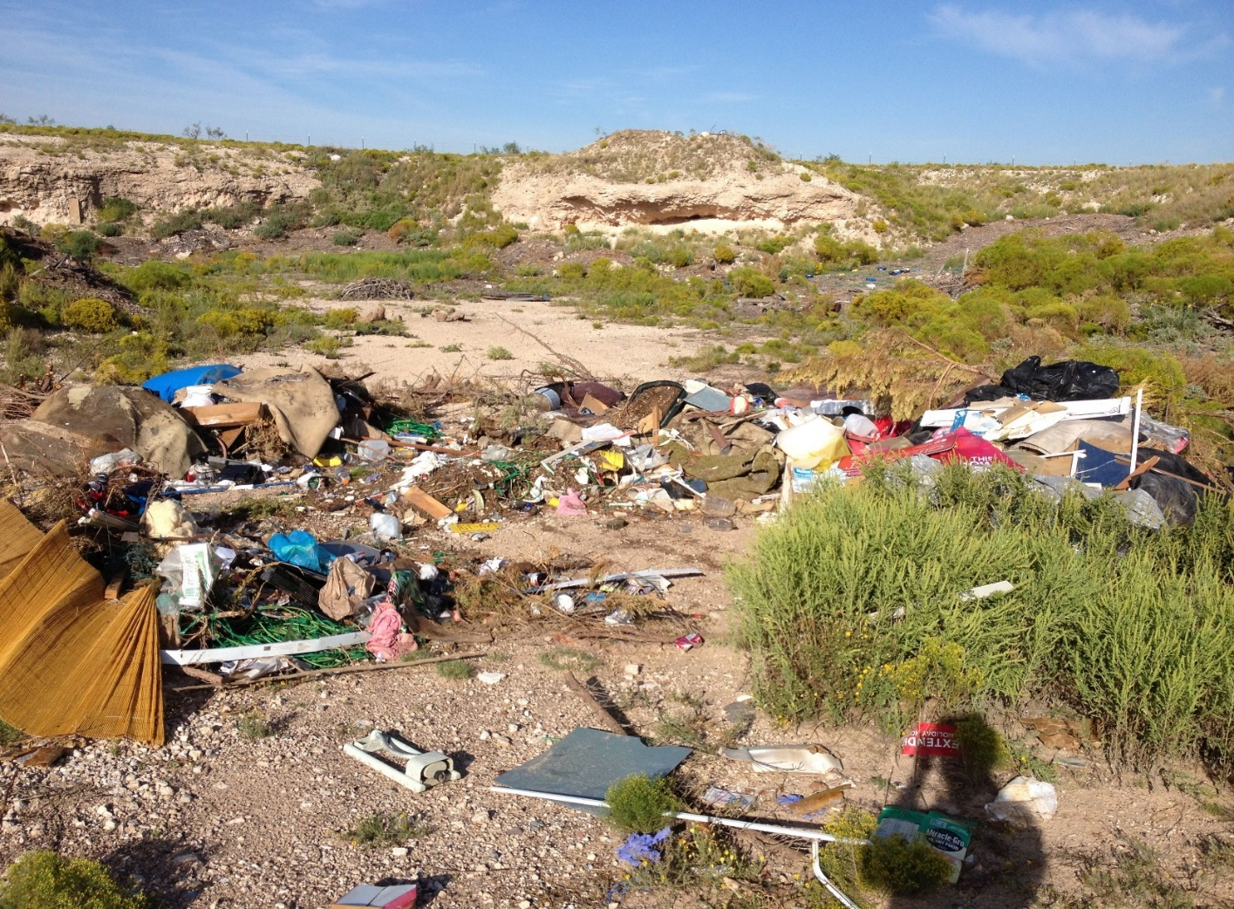
SIANA SPILL
ILLEGAL DUMPING

Slide 25
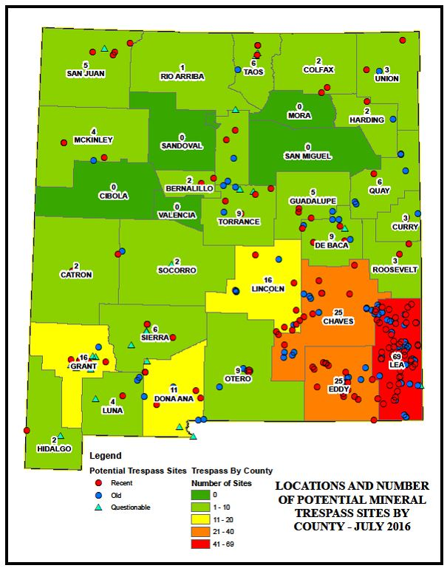
Caliche Trespass
Dozens of Potential Caliche Pit Trespass Sites Discovered Since March 2016
6 Caliche Pit Trespass Sites Resolved
6 Restitution Settlements Received ($108,912.00, $280,526.00, $35,000.00, $320,559.00, $115,974.00 and $33,190.50)
Total Restitution Value = $894,161.50 (Plus 3 Leases Going Forward With Additional Monthly Earnings)
6 More Sites Currently Under Investigation With More To Follow

Slide 26
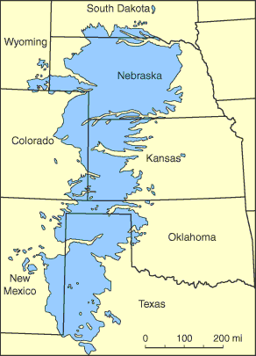
Ogallala Aquifer
Located beneath the Great Plains with portions in eight states, including eastern New Mexico.
Provides nearly all the water for residential, industrial, and agricultural use.
Ogallala Aquifer is being both depleted and polluted and little of it is replaced by recharge from rainwater and snowmelt from the Rocky Mountains.
At the current rate of water use, the aquifer could be depleted in only a few decades.
Once depleted, the aquifer could take over 6,000 years to replenish naturally through rainfall.
Effective July 1, 2017, the State Land Office will not approve new or renewal water easements that involve the use of fresh water from the Ogallala aquifer for oil and gas production and related activities.

Slide 27
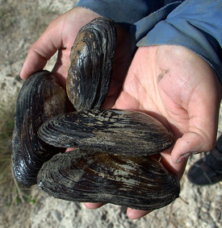
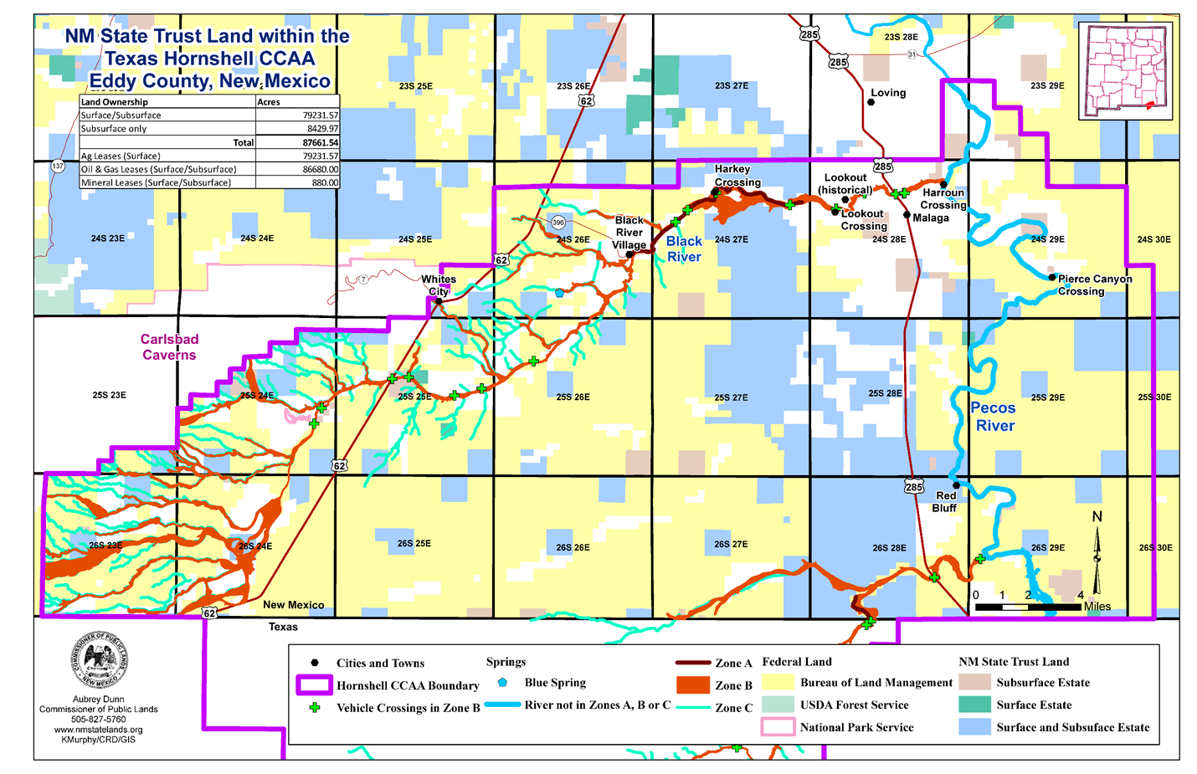
Endangered Species – Texas Hornshell Mussel

Slide 28
Endangered Species:
Lesser Prairie Chicken and Sand Dune Lizard CCAA

Slide 29
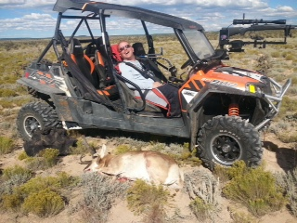
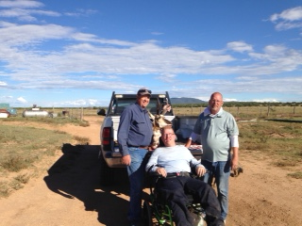
Wounded Warrior

Slide 30

THANK YOU

