Slide 1
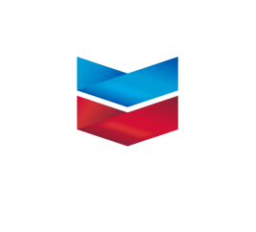
The Opportunity of the Permian

Slide 2
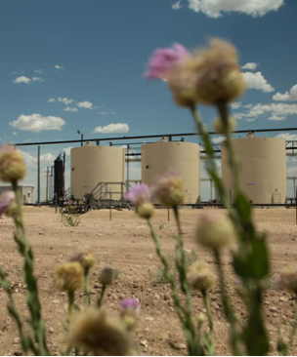
Chevron has called Permian home for close to a century
Chevron and its legacy companies have been a fixture in the Permian since early 1920s.
Produced our 5 billionth barrel from Permian in 2011
Are among the largest producers of oil and natural gas in the basin
Among largest undeveloped leaseholders
Operations include unconventional and conventional wells, disposal and injection wells, waterfloods and CO₂ floods

Slide 3
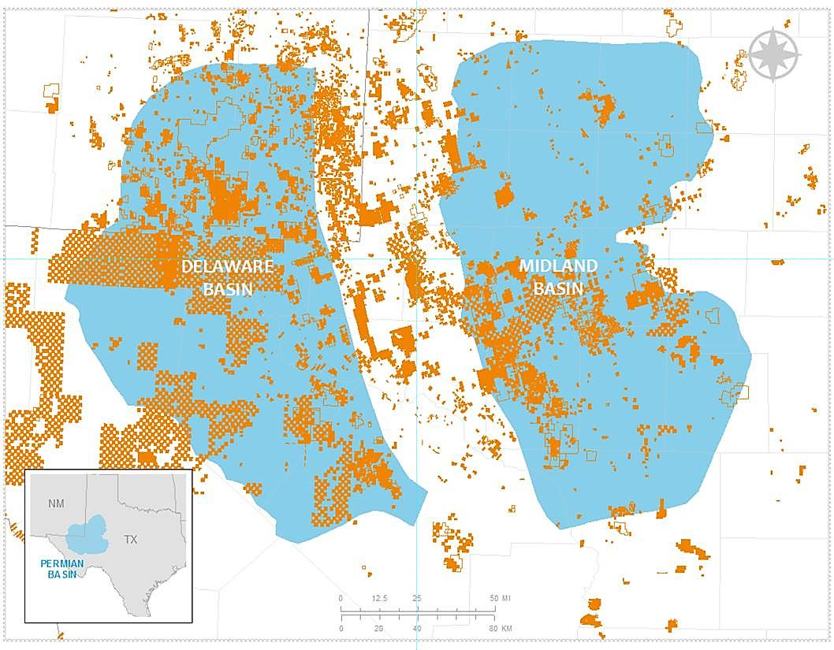
Permian Basin is key contributor to Chevron’s portfolio
Current Scope in the Permian
1.5 million net acres
150 MBOE/D net production
>200 company operated and joint venture wells drilled in 2016
12 operated rigs
Chevron in New Mexico
Strong land position that holds some of our most prospective opportunities
3 offices
~210 employees and contractors

Slide 4
With great potential for growth and value creation
Investing more than $2 billion in shale and tight resources this year
20 rigs by 2018
Potential production of >700 MBOED within a decade

Slide 5
Key areas industry needs to ensure success in New Mexico
Economics, economics, economics…
Established supply chain
Commercial and infrastructure options
Support from communities
Stable regulatory framework

Slide 6
Collaboration is critical across and beyond industry
All regulatory levels: local, state and federal
Stakeholders: communities, nonprofits and environment groups, service providers
Industry associations: NMOGA, PBPA, IPANM, TXOGA

Slide 7
Southeast New Mexico is transforming into an energy powerhouse
Permian is important to Chevron, industry, our communities and the country
Collaboration and innovation is all of our responsibility
The opportunity for New Mexico can be transformational

