Slide 1
Akuo Energy USA
NM EnergyPlex Conference
June 28, 2017

Slide 2
Introduction
Akuo Energy – Overview
AEM Wind LLC / The Sterling Wind Project
NM Renewable Energy Opportunities

Slide 3


Akuo Energy – Overview
Independent Power Producer
Founded in 2007
Paris Based
Geographic and Technological Diversified
1,100 MW in operation, under construction or with financing underway
3 GW in global pipeline
Multi Renewable Energy Player
Wind
Solar
Biomass
Hydro
Marine energy

Slide 4
Akuo Energy – Overview
Our Strategy
Long Term Vision: long term hold
  develop,
  construct
  operate
Global Player with offices in 13 countries:
France Poland Croatia
Turkey USA Indonesia
Uruguay Dubaï Australia
Mongolia Morocco Dominican Republic
Mali

Slide 5
Akuo Energy – Overview
Proven Expertise with Exponential Growth:
Fast growing: double in size 2013 to 2015 to 2017
€ 172 million in electricity sales as of the end of 2016
€ 1.9 billion cumulative investment of since inception.

Slide 6
Akuo Energy – Overview
Akuo USA
Founded in 2008
Chicago US Head Quarters
San Antonio host regional operations center
Operational
AEM / Sterling Wind, NM 29.9MWs – COD July 2017
Rocksprings Wind, Texas 150MWs – COD Sept 2017

Slide 7
Akuo Energy – Overview
Akuo USA
Pipeline
Sugar Creek Wind 200MWs - Indiana
Minonk Wind 100MWs – Illinois
Sterling Phase II Wind and/or Solar 50MWs – New Mexico
Blue Valley Ranch Wind and/or Solar 200MWs - Texas
Ballenger Ranch Wind 200MWs – Texas
Clark Ranch Wind 200MWs – Texas
Various Solar Projects

Slide 8
AEM Wind LLC / Sterling Wind Project
Project Overview:
Project located north of Tatum
Project include 13 – GE 2.3MW 116
The total capacity of the project is 30MW

Slide 9
AEM Wind LLC / Sterling Wind Project
Project Layout

Slide 10
AEM Wind LLC / Sterling Wind Project
Project Schedule
Close of financing – October 2016
Mobilization to site – February 2017
First Foundation Poured – March16, 2017
First Turbine Delivered – May 1, 2017
First Turbine in Operation – June 27, 2017
Full operation – target completion July 10, 2017

Slide 11
AEM Wind LLC / Sterling Wind Project
Project Attributes
Project impacts 10 acres of the 5000 acres footprint
Over 45,000 construction man hours
Safety during the 126 days of construction
No lost time incident
No environmental issues
What has been put in place:
5,000CY of Concrete
25 miles of underground cable
4 miles of new ranch road

Slide 12
AEM Wind LLC / Sterling Wind Project
Project impact on the local community
Pettigrew provided land surveying and inspection services
Elliot & Waldron is the Title Agent
LCEC provided transmission services
LeaCo provides Internet Services
Approx. 80 people lived in Tatum or Lovington during the construction
General Contractor used supply and services from the County such as Concrete supply, equipment rental, etc…

Slide 13
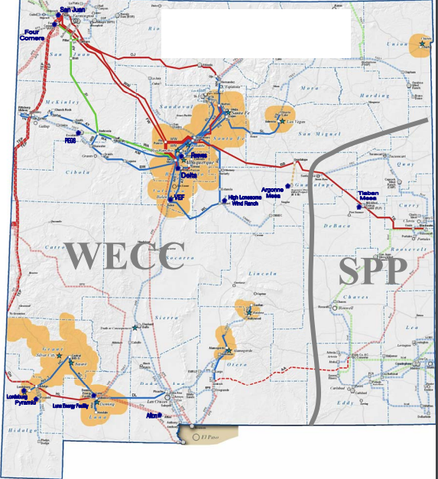
NM Renewable Energy Opportunities
NM Power Market is two markets – WECC & SPP
WECC is a bi-lateral market:
energy generated must be delivered physically to the ultimate off-taker
SPP is a LMP (Localized Market Pricing) market: generating facility can either
(a) deliver physical power
(b) sell energy into the merchant/spot market
(c) settle financially for energy generated

Slide 14
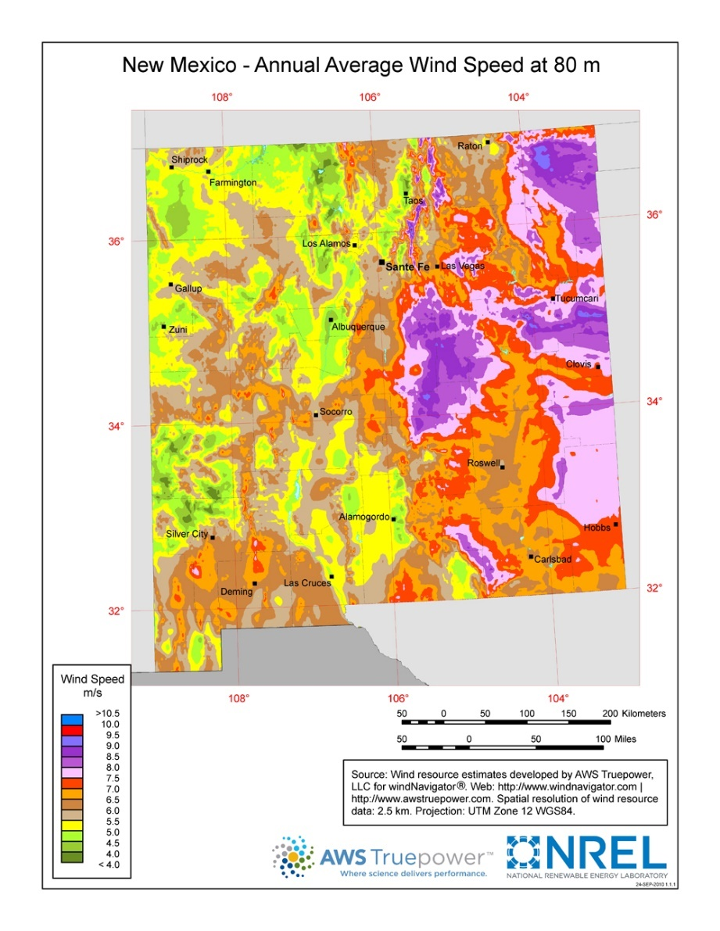
NM Renewable Energy Opportunities
New Mexico Renewable Energy Resources
Excellent wind resource in east (SPP) – Including LEA COUNTY

Slide 15
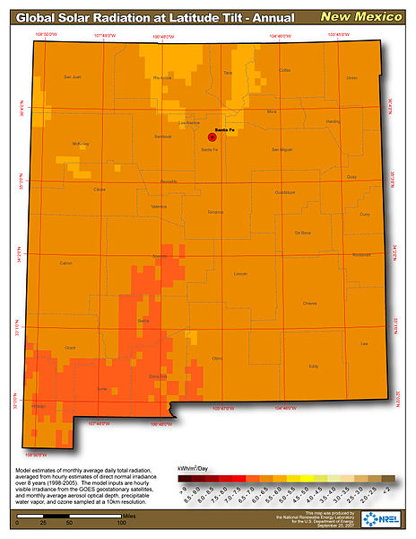
NM Renewable Energy Opportunities
NM Renewable Energy Resources
Excellent solar resources, primarily in the southwest (WECC)

Slide 16
NM Renewable Energy Opportunities
Going Forward:
The Akuo Team looks forward to great opportunities in NM
AEM / Sterling Phase II – 50MWs
Spartan Wind 100MWs, San Jon, NM

Slide 17
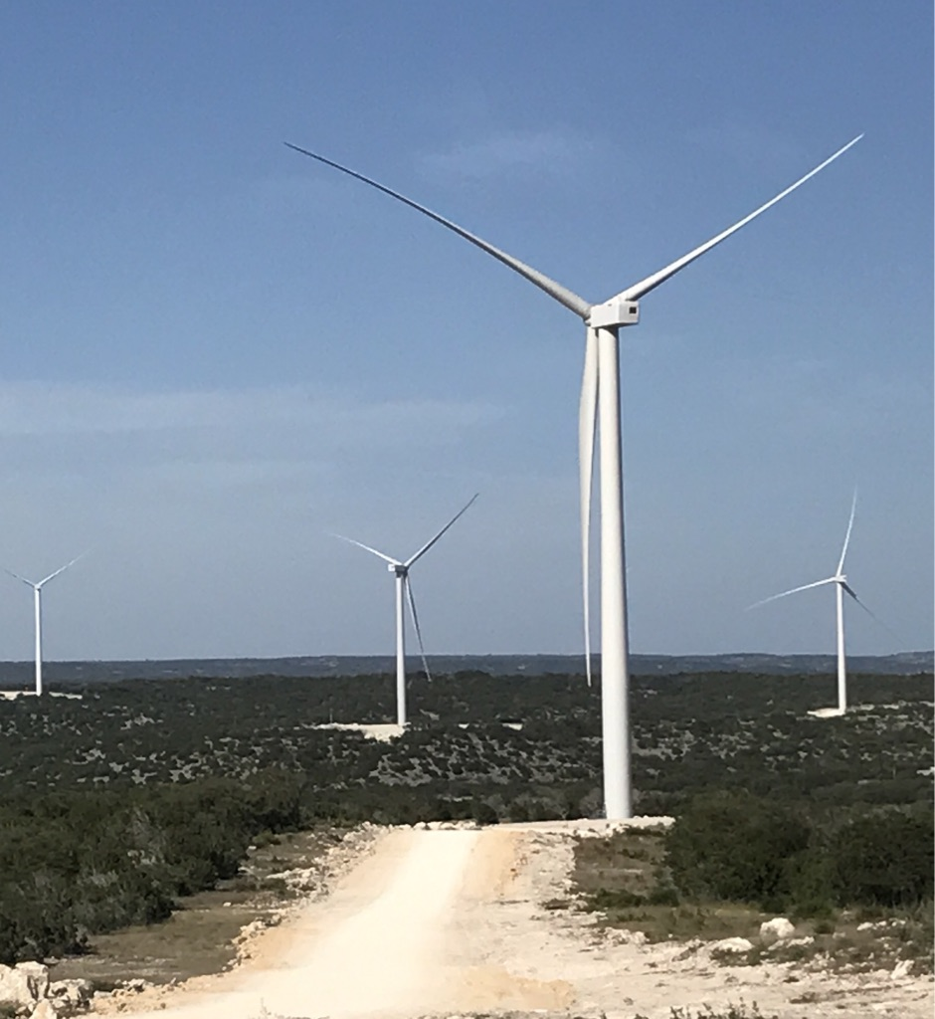
Thank you for your continued support

